Slide 1
Founder SuperLine 4.70

Slide 2
Content
What is Founder SuperLine?
Key Features
Advantages
Benefits
Target Markets

Slide 3
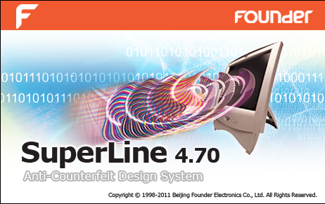
SuperLine 4.70

Slide 4
What is SuperLine?
Founder SuperLine Anti-Counterfeit Design System is digital design software for security against counterfeit and forgery of almost any printed items.
Founder SuperLine's target clients are organizations that design documents that are vulnerable to counterfeit, such as banknotes, packaging, passports, certificates, licenses, lottery tickets, contracts, trademarks, etc..

Slide 5
Key Features

Slide 6
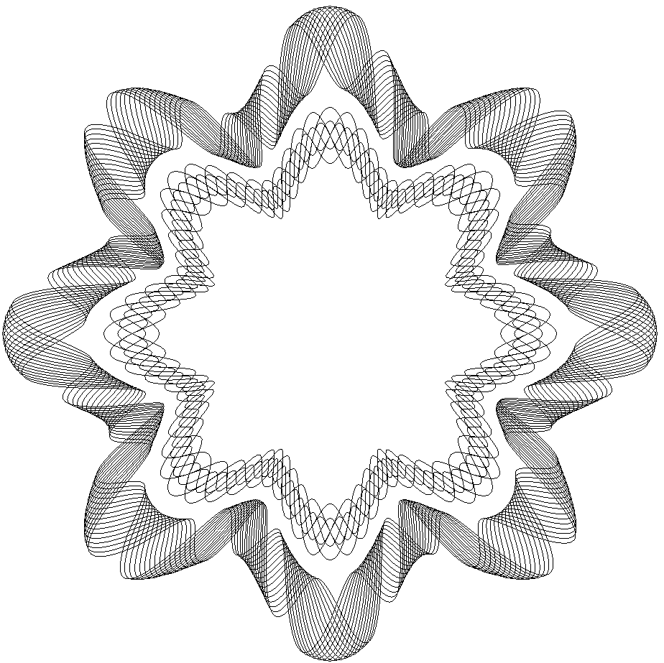
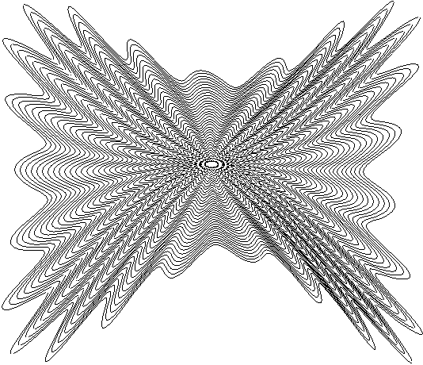



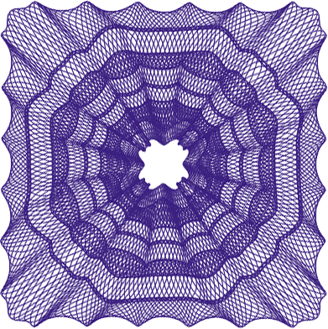

Key Features
Guilloche
  An ornamental pattern formed of two or more curved bands that interlace to repeat a circular design
  Often used on banknote, bill, identification card, and passport for added security against counterfeiting. Line density and interlacement are used to enhance the effect of a guilloche
  SuperLine provides a set of power tools to generate guilloche in different shape effortlessly

Slide 7
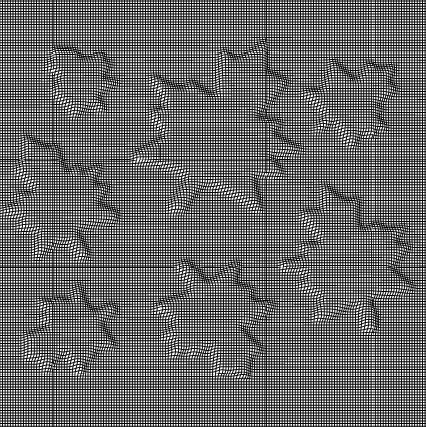
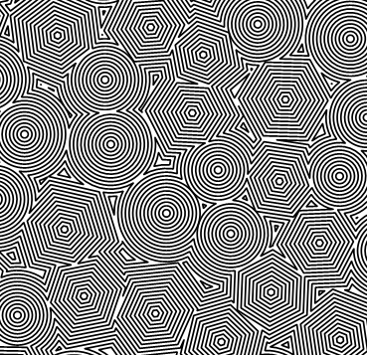
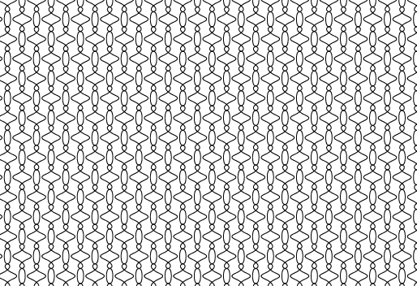
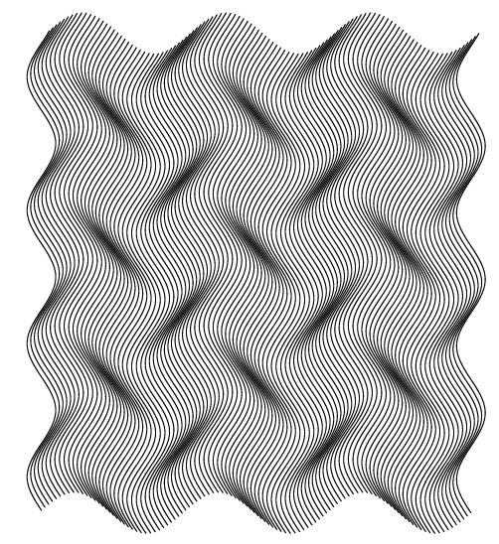
Key Features
Texture
  Made by repeatedly varying an element so that it formulates an area of regular, interwoven, and interchangeable gridlines
  Often found in banknote, check book, air ticket, ID, badge, etc., with the line formation being sparse or dense, visible or invisible
  SuperLine offers a powerful element making toolkit including copy, mirror, array and texture generator to generate texture at ease

Slide 8
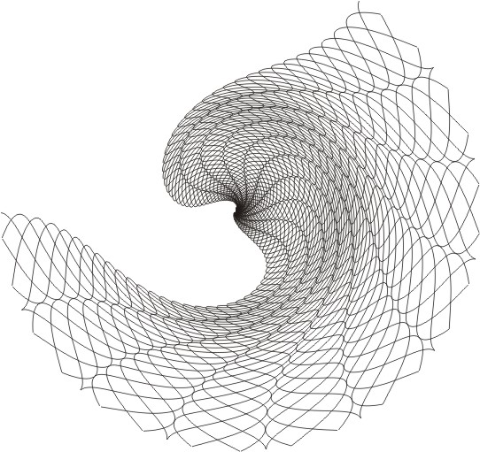
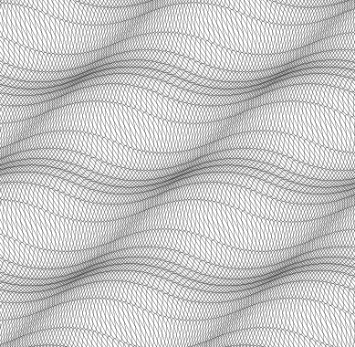
Key Features
Filter
  A unique function contains:
    Fish-eye
    Graphic filter
    Density filter
  Handy for texture generation
  Offers special effect with personal touch for creative artists

Slide 9
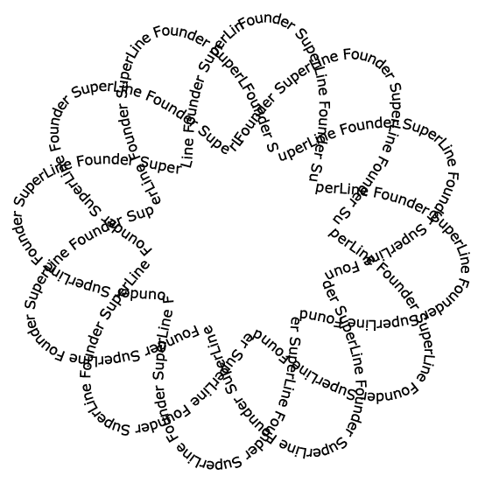
Key Features
Microtext
  Generated by very small letters instead of lines, e.g. replacing a line segment with a line of letters which usually come shorter than 0.2mm
  Useful in the anti-counterfeiting design for certificate and identification card
  Because SuperLine allows very small letters to form microtext, the designer only needs to care about whether the output hardware can achieve the accuracy in postpress

Slide 10
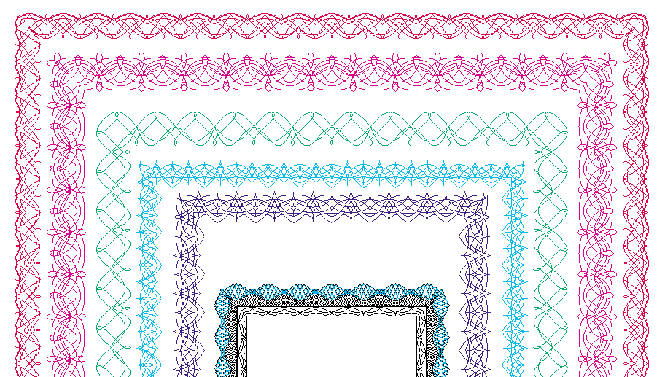
Key Features
Lace

Slide 11


Key Features
Latent

Slide 12
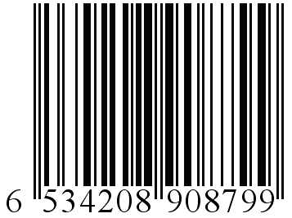
Key Features
Bar code

Slide 13
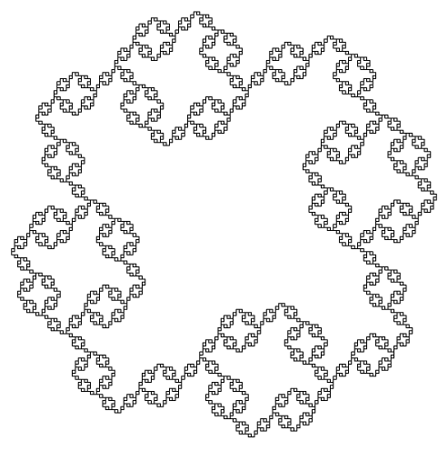
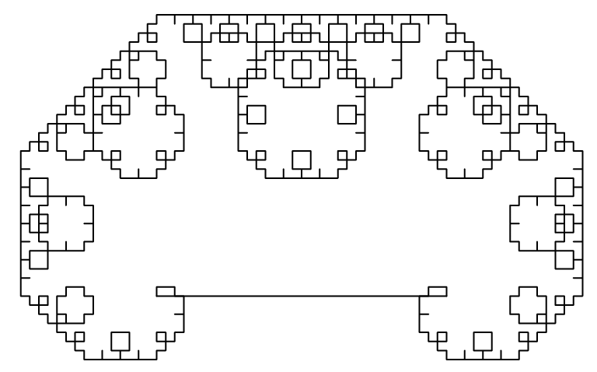
Key Features
Fractal
  generate random and iterative graphics.

Slide 14
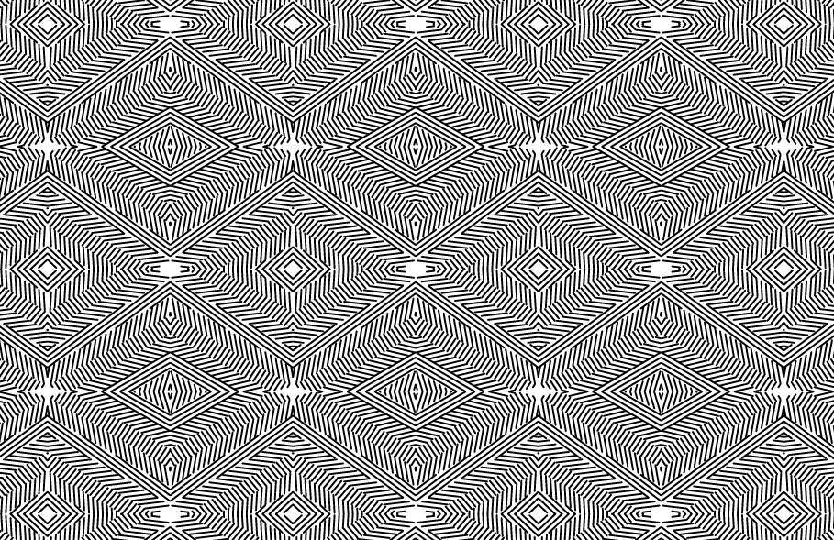
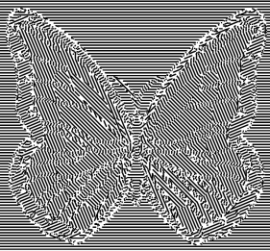
Key Features
Refraction

Slide 15
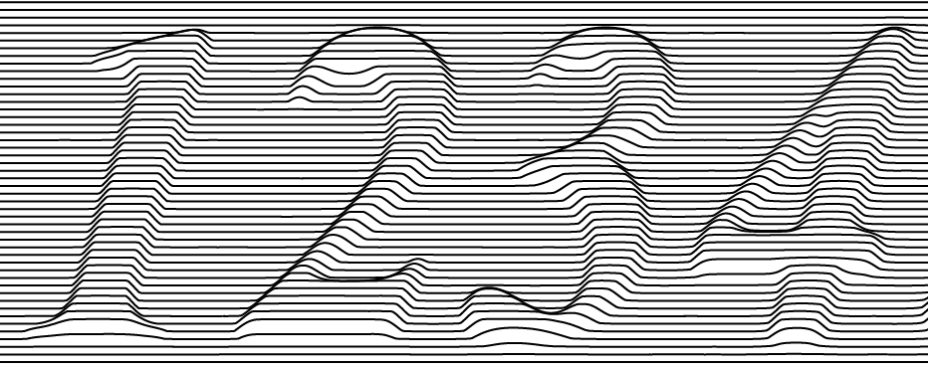

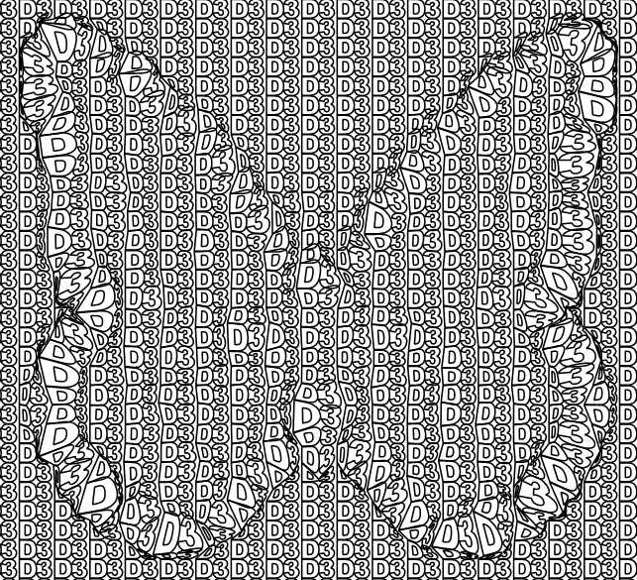
Key Features
Relief

Slide 16

Key Features
Split Line

Slide 17
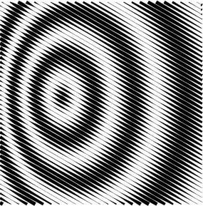
Key Features
Engraving

Slide 18
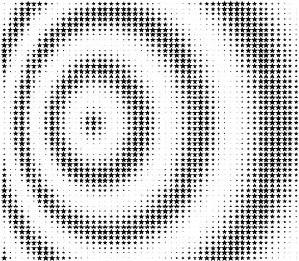

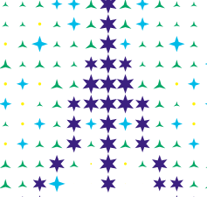
Key Features
Rasterize & Multiple Rasterize

Slide 19
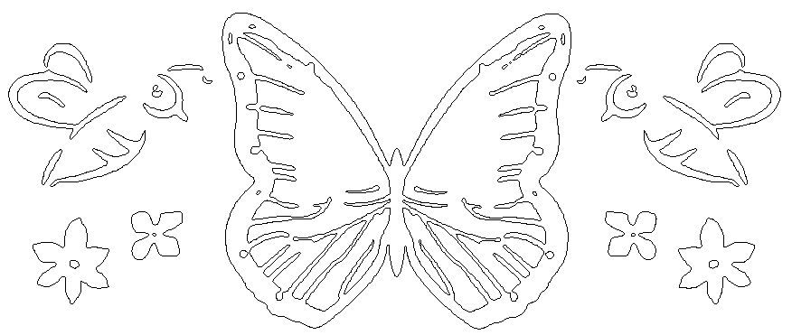
Key Features
Image Contour

Slide 20
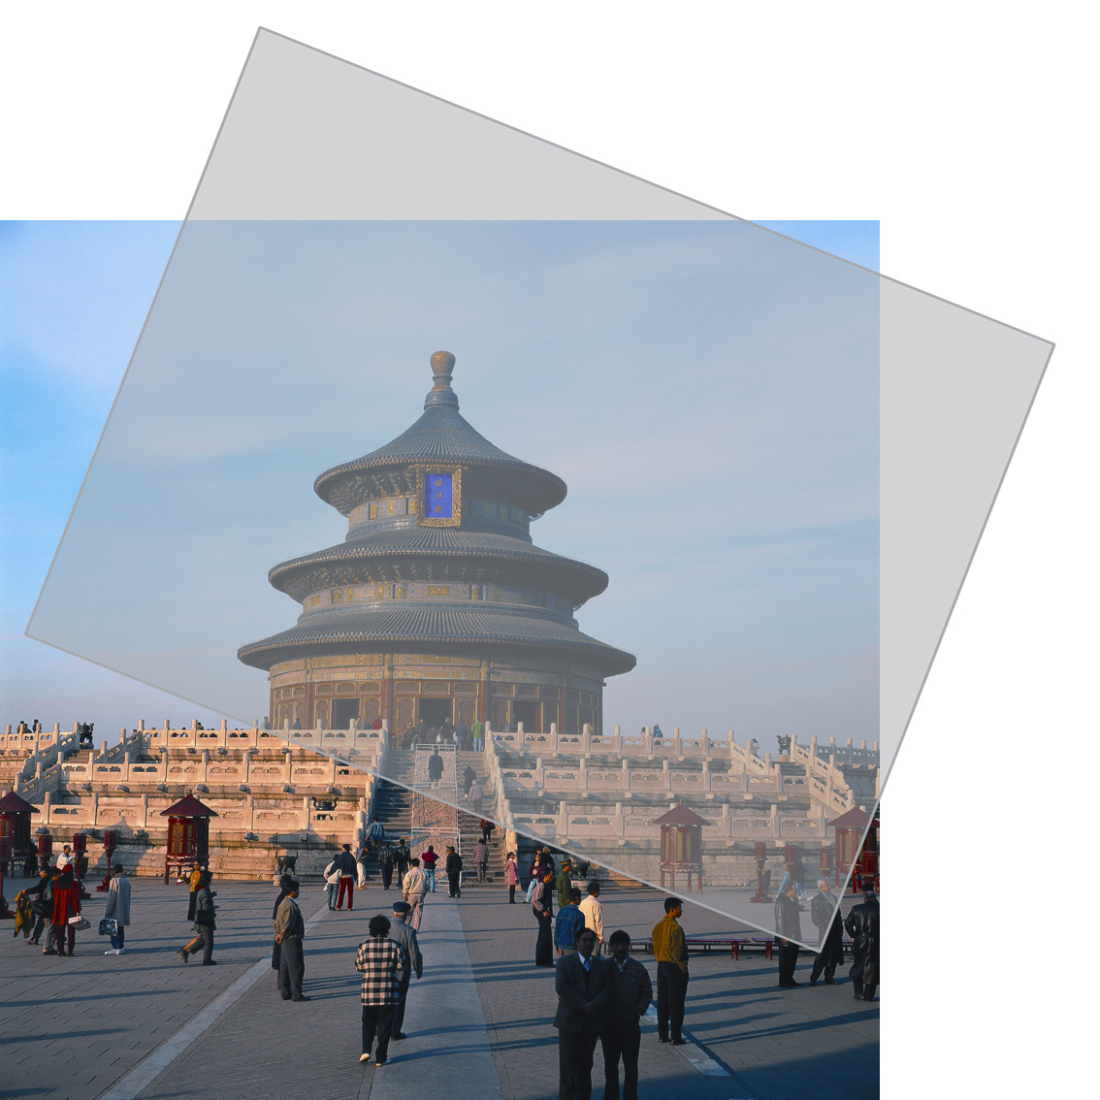

Key Features
Lock and opening
  To overlay a film on the image, and view from a certain angle, you will see a hiding pattern on the image
  The key to open the lock is the film with special screening

Slide 21



Key Features
Output Pattern
  Output the background pattern designed in SuperLine to Founder DocuDefend application
Design
then
output pattern
Imported into
Founder DocuDefend
Application
Copied

Slide 22
Key Features
Module list
Guilloche
Texture
Lace
MicroText
SplitLine
Latent
Lock-Opening
Rasterization
Refraction
Relief
Basic Tools

Slide 23
Advantages

Slide 24
Advantages
Superior price/performance: high end solution at competitive price
Enhanced various security elements
Robust design and layout functionalities
Ease-to-use GUI similar to popular page layout software
Modularized SDK available for OEM

Slide 25
Benefits

Slide 26
Benefits
Cost Effectiveness
  SuperLine is digital design software and implements its security features in the printing process, without incurring the extra cost of traditional solutions
Pleasing Aesthetic Effect
  Harmonious pattern, grid, and texture
Strong Security Features
  Sophisticated, mutable lines and texture
  Anti-scanning and anti-replicating

Slide 27
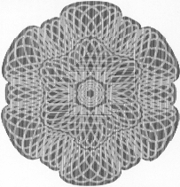
Benefits
Anti-scanning
  All the elements are not screen dots but solid lines. If being scanned, they will become dots
  Variable line width effectively prevent line work from being scanned
  Result can be distinguished by naked eye
Original
Fake

Slide 28
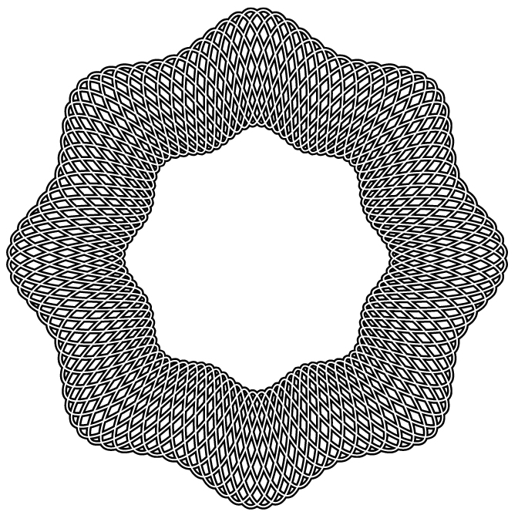
Benefits
Anti-Replicating Cannot be replicated by common layout software including:
  Adobe Illustrator
  Freehand
  CorelDraw…

Slide 29
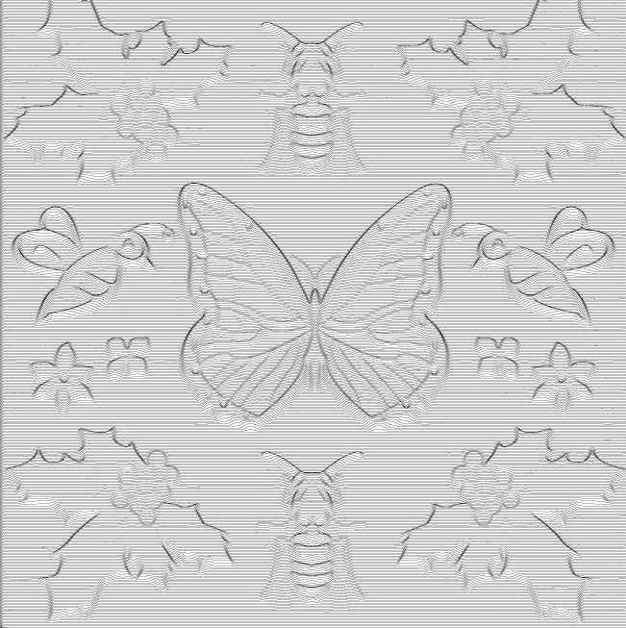
Benefits
Anti-Replicating
  Cannot be replicated even by the same SuperLine software
  Some effect based on image where you cannot achieve the same effect without original image
  Stochastic parameter is used to prevent forgery

Slide 30
Target Markets

Slide 31
Target Markets
Bank notes and finance
Commercial notes
  Certificates, licenses, passports, ID, tickets, lottery, agreements etc. …
Packaging and trademarks
  High value goods, and medicines, liquor, tobacco, cosmetics …

Slide 32
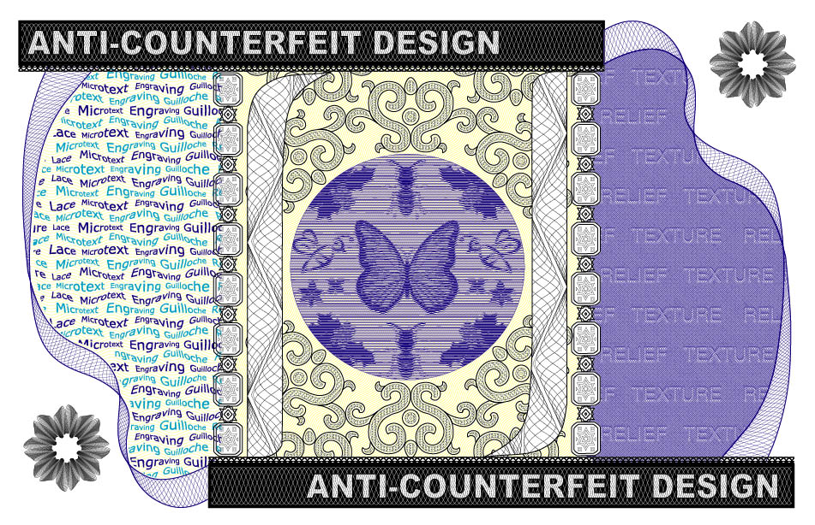
Samples

Slide 33
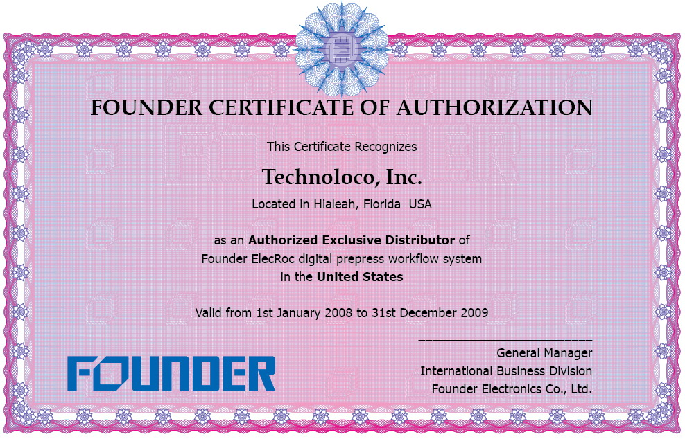
Samples

Slide 34
http://www.founder.com.cn
gasupport@founder.com
Beijing Founder Electronics Co., Ltd.
9, No.5 Street, Shangdi Information Industry Base, Haidian District, Beijing 100085, P.R.China
Tel: +86 10 62981440 Fax: +86 10 62981440
Email: GASales@founder.com.cn

