Slide 1
Guilloche

Slide 2
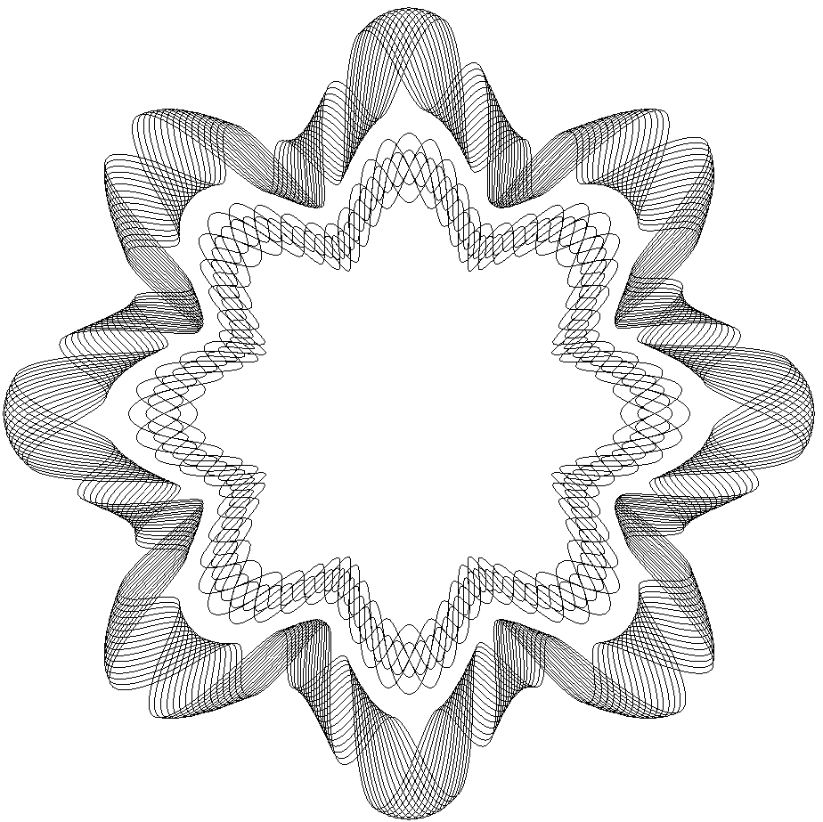
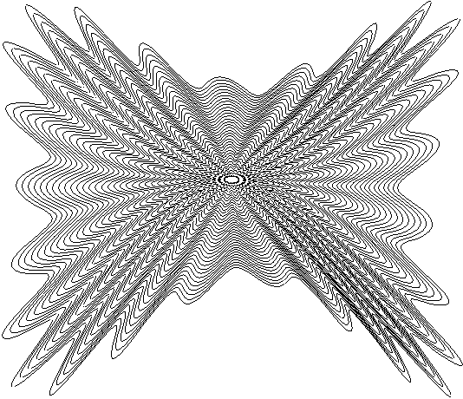
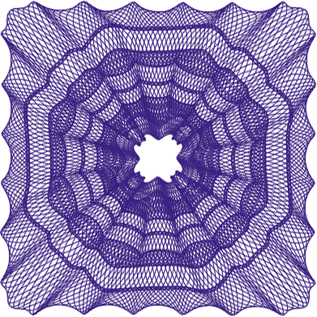
Guilloche
Guilloche
An ornamental pattern formed of two or more curved bands that interlace to repeat a circular design
Often used on banknote, bill, identification card, and passport for added security against counterfeiting. Line density and interlacement are used to enhance the effect of a guilloche
SuperLine provides a set of power tools to generate guilloche in different shape effortlessly

Slide 3
Guilloche
Guilloche1

Slide 4
Guilloche
Guilloche2

Slide 5
Guilloche
Guilloche3

Slide 6
Guilloche
Guilloche4

Slide 7
Guilloche
Guilloche5

Slide 8
Guilloche
Guilloche6

Slide 9
Guilloche
Guilloche7-fixnode

Slide 10
Guilloche
Guilloche8-advanced1

Slide 11
Guilloche
Guilloche9-advanced2

Slide 12
Guilloche
Guilloche10-advanced3

Slide 13
Guilloche
Guilloche11

Slide 14
Guilloche
Guilloche12

