Slide 1
Texture

Slide 2
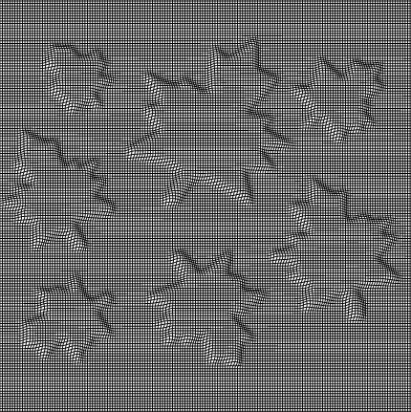
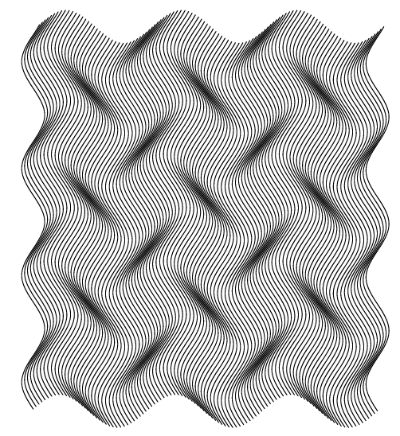
Texture
Texture
Made by repeatedly varying an element so that it formulates an area of regular, interwoven, and interchangeable gridlines
Often found in banknote, check book, air ticket, ID, badge, etc., with the line formation being sparse or dense, visible or invisible
SuperLine offers a powerful element making toolkit including copy, mirror, array and texture generator to generate texture at ease

Slide 3
Texture
Texture1

Slide 4
Texture
Texture2

Slide 5
Texture
Texture3

Slide 6
Texture
Texture4

Slide 7
Texture
Texture5

Slide 8
Texture
Texture6

Slide 9
Texture
Texture7

