Slide 1
MicroText

Slide 2
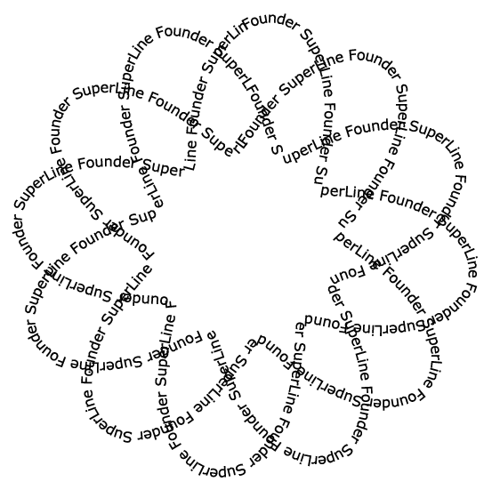
MicroText
MicroText
Generated by very small letters instead of lines, e.g. replacing a line segment with a line of letters which usually come shorter than 0.2mm
Useful in the anti-counterfeiting design for certificate and identification card
Because SuperLine allows very small letters to form microtext, the designer only needs to care about whether the output hardware can achieve the accuracy in postpress

Slide 3
MicroText
MicroText

