Slide 1
Lock-Opening

Slide 2
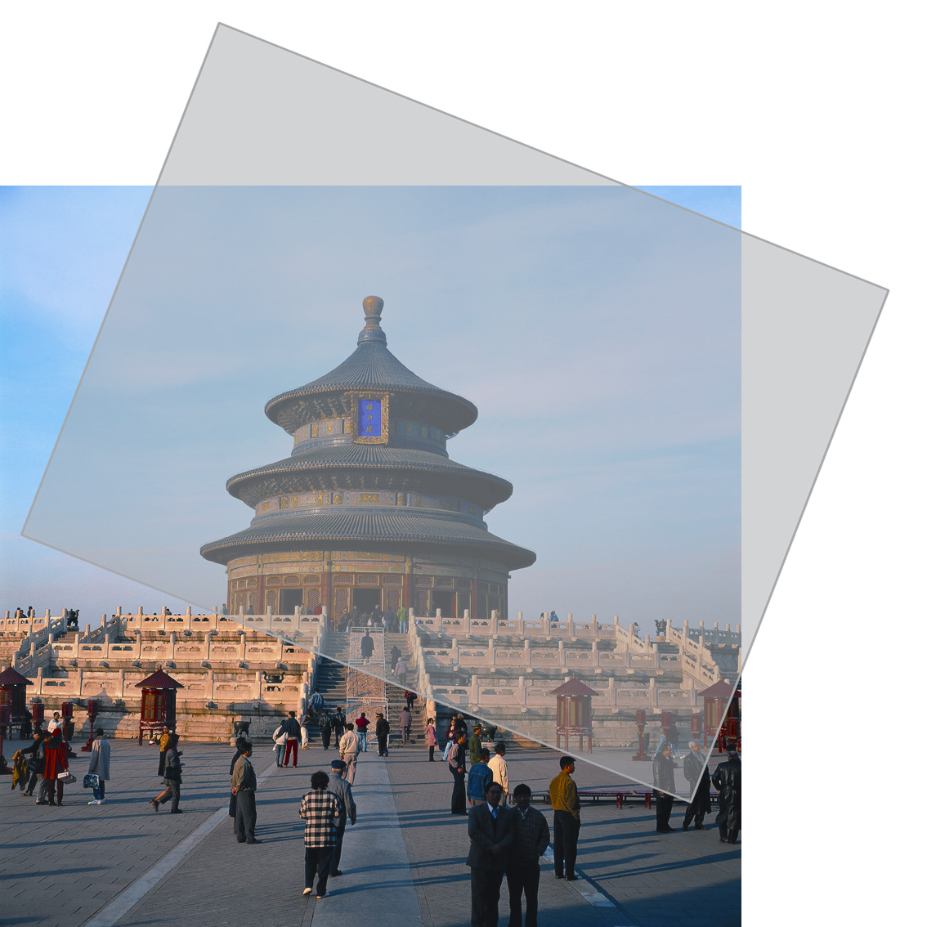
Lock-Opening
Lock-Opening
To overlay a film on the image, and view from a certain angle, you will see a hiding pattern on the image.
The key to open the lock is the film with special screening.

Slide 3
Lock-Opening
Lock-Opening1

Slide 4
Lock-Opening
Lock-Opening2

Slide 5
Lock-Opening
Lock-Opening3

Slide 6
Lock-Opening
Lock-Opening4

Slide 7
Lock-Opening
Lock-Opening5

