Slide 1
Relief

Slide 2
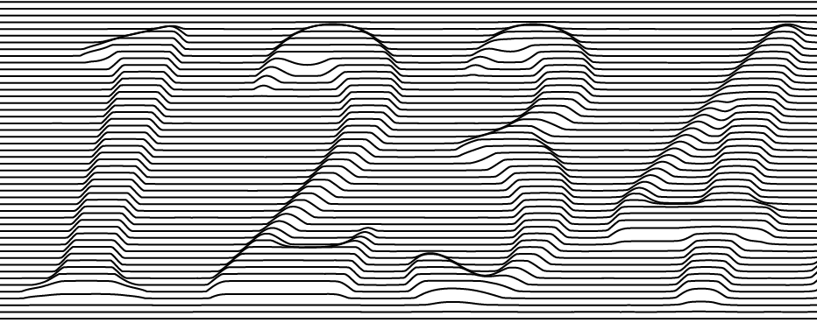
Image Relief
Relief

Slide 3
Relief
Relief on Curve

Slide 4
Relief
Relief on Line

Slide 5
Relief
Relief on Split Line

