Slide 1
Refraction

Slide 2
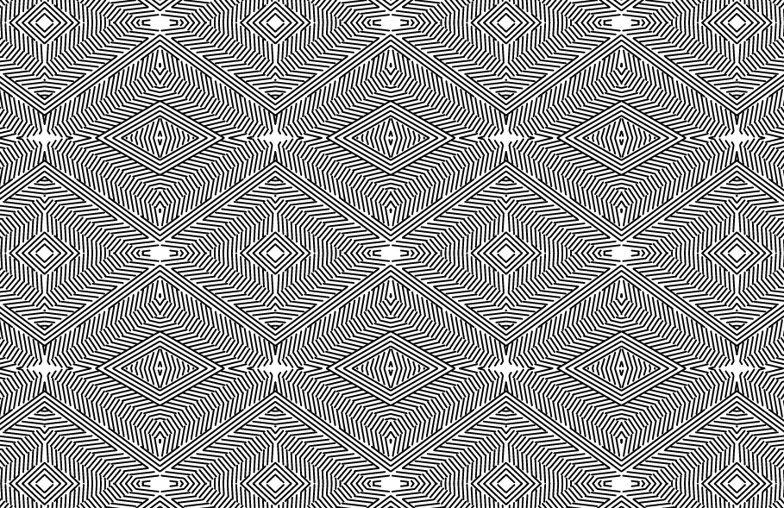
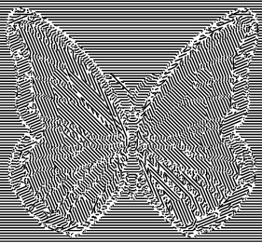
Refraction
Refraction

Slide 3
Refraction
Refraction

