Slide 1
Filter

Slide 2
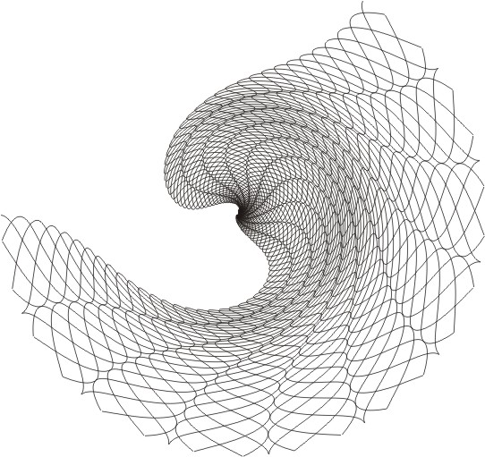
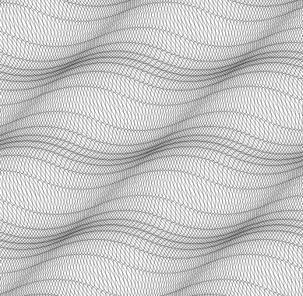
Filter
Filter
A unique function contains:
Fish-eye
Graphic filter
Density filter
Handy for texture generation
Offers special effect with personal touch for creative artists

