Slide 1
Fractal

Slide 2
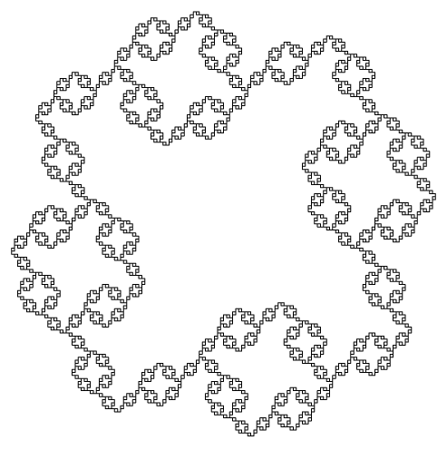
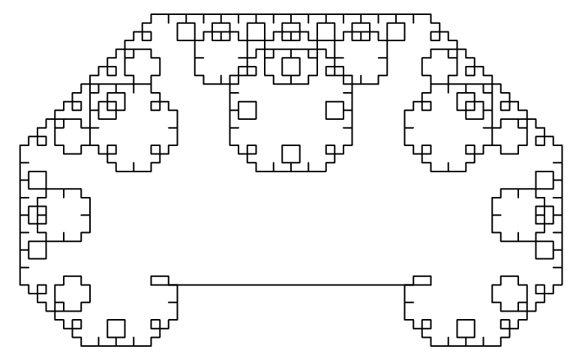
Fractal
Fractal
generate random and iterative graphics.

