Slide 1
Founder SuperLine 4.71

Slide 2
Content
What is Founder SuperLine?
Key Features
Advantages
Benefits
Target Markets

Slide 3
What is SuperLine?
Founder SuperLine Anti-Counterfeit Design System is digital design software for security against counterfeit and forgery of almost any printed items.
Founder SuperLine's target clients are organizations that design documents that are vulnerable to counterfeit, such as banknotes, packaging, passports, certificates, licenses, lottery tickets, contracts, trademarks, etc..

Slide 4
Key Features

Slide 5
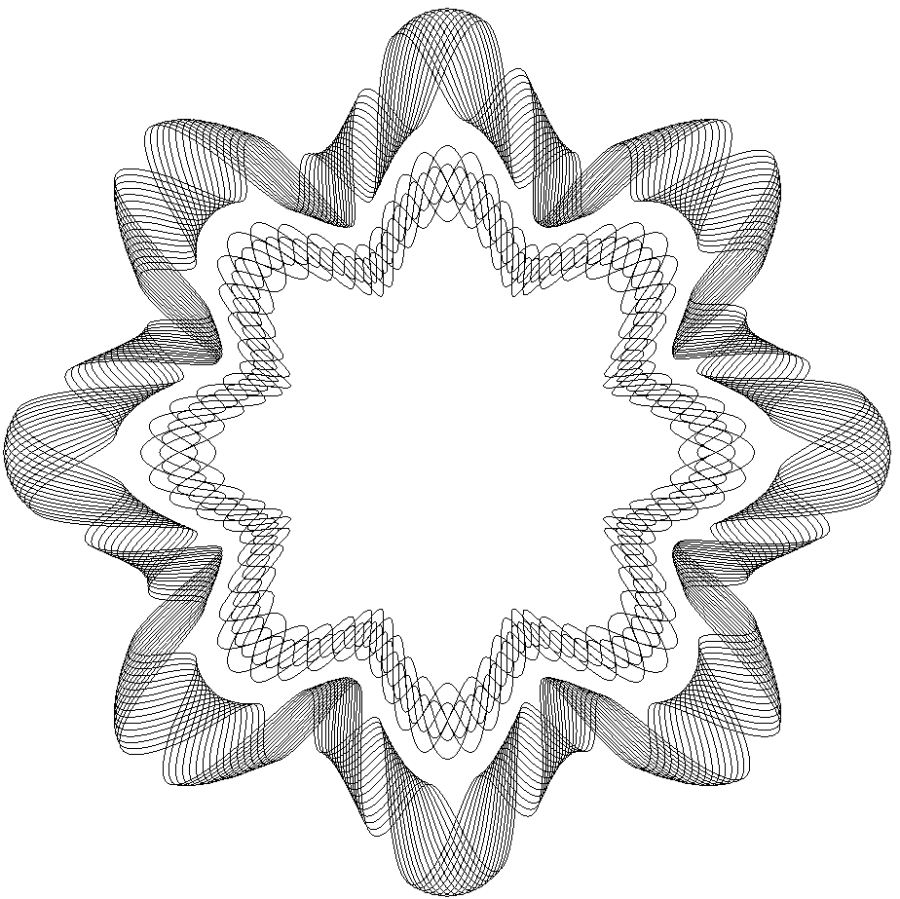
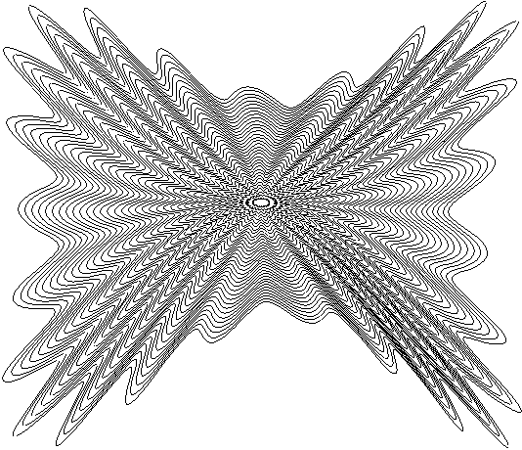
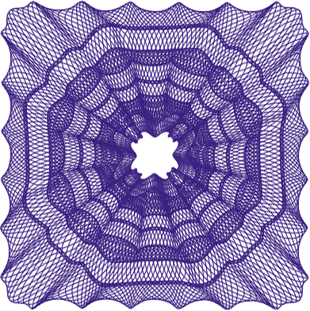
Key Features
Guilloche
An ornamental pattern formed of two or more curved bands that interlace to repeat a circular design
Often used on banknote, bill, identification card, and passport for added security against counterfeiting. Line density and interlacement are used to enhance the effect of a guilloche
SuperLine provides a set of power tools to generate guilloche in different shape effortlessly

Slide 6
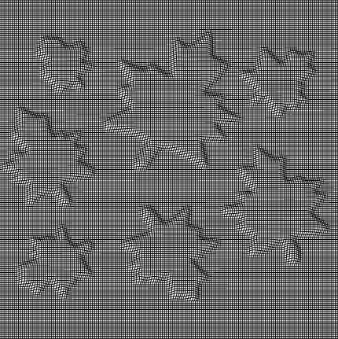
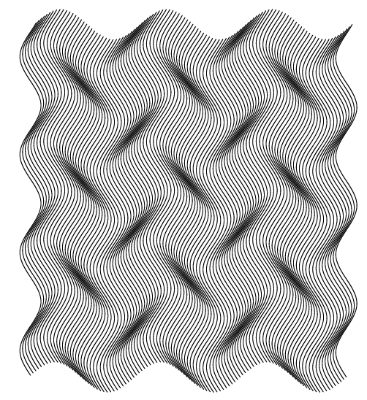
Key Features
Texture
Made by repeatedly varying an element so that it formulates an area of regular, interwoven, and interchangeable gridlines
Often found in banknote, check book, air ticket, ID, badge, etc., with the line formation being sparse or dense, visible or invisible
SuperLine offers a powerful element making toolkit including copy, mirror, array and texture generator to generate texture at ease

Slide 7
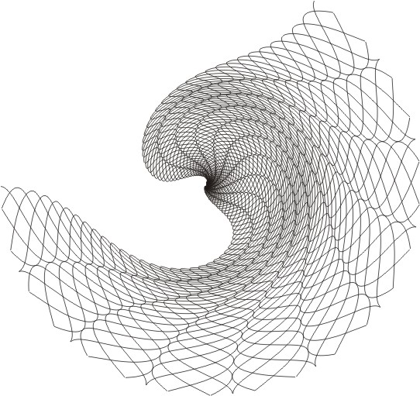
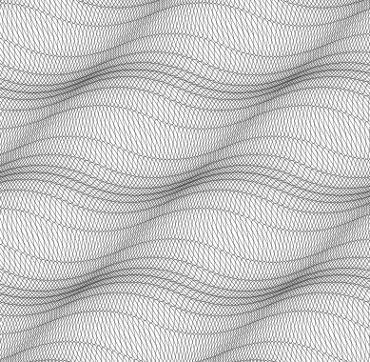
Key Features
Filter
A unique function contains:
Fish-eye
Graphic filter
Density filter
Handy for texture generation
Offers special effect with personal touch for creative artists

Slide 8
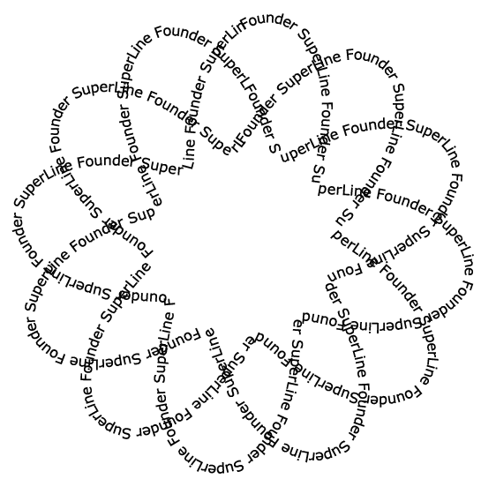
Key Features
Microtext
Generated by very small letters instead of lines, e.g. replacing a line segment with a line of letters which usually come shorter than 0.2mm
Useful in the anti-counterfeiting design for certificate and identification card
Because SuperLine allows very small letters to form microtext, the designer only needs to care about whether the output hardware can achieve the accuracy in postpress

Slide 9
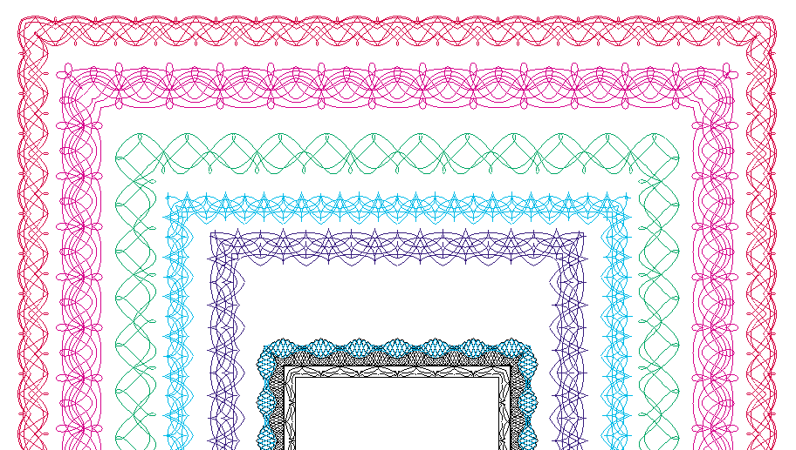
Key Features
Lace

Slide 10
Key Features
Latent

Slide 11
Key Features
Bar code

Slide 12
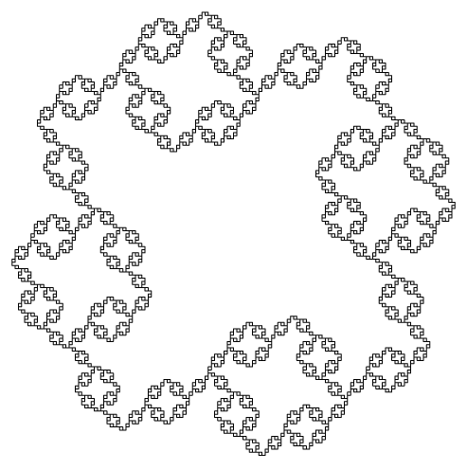
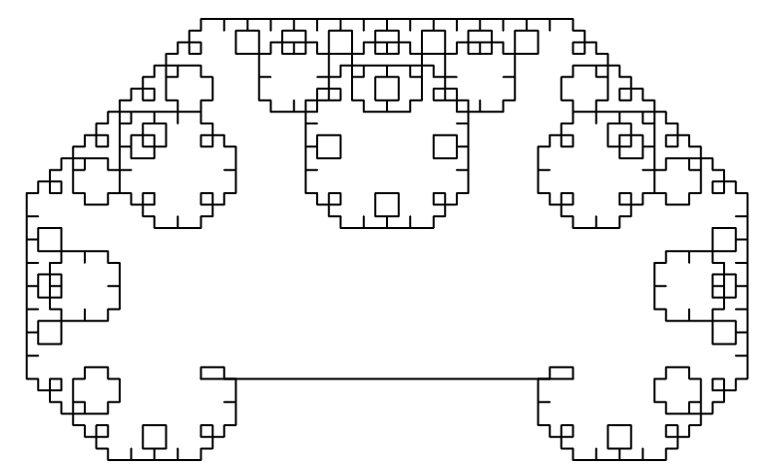
Key Features
Fractal
generate random and iterative graphics.

Slide 13
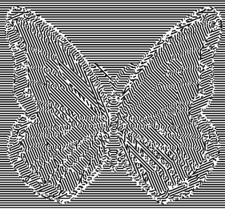
Key Features
Refraction

Slide 14
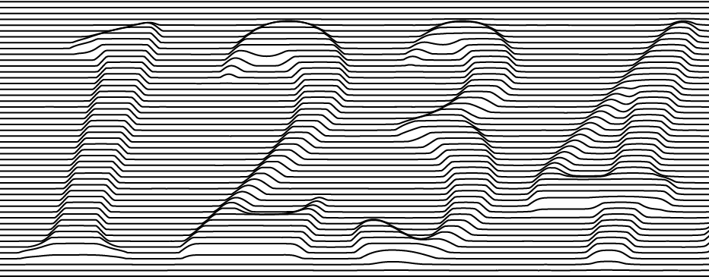
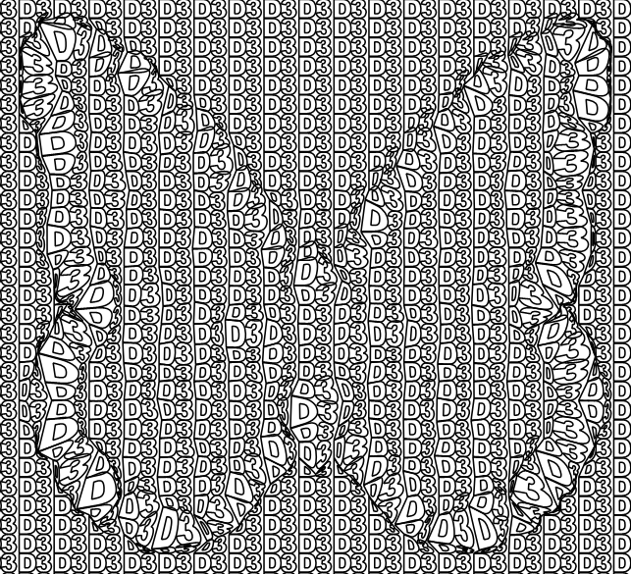
Key Features
Relief

Slide 15
Key Features
Split Line

Slide 16
Key Features
Engraving

Slide 17
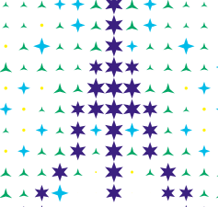
Key Features
Rasterize & Multiple Rasterize

Slide 18
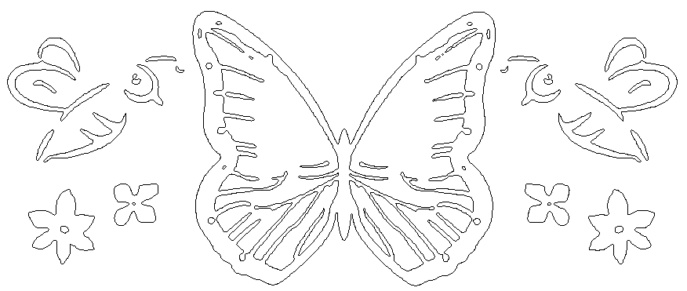
Key Features
Image Contour

Slide 19
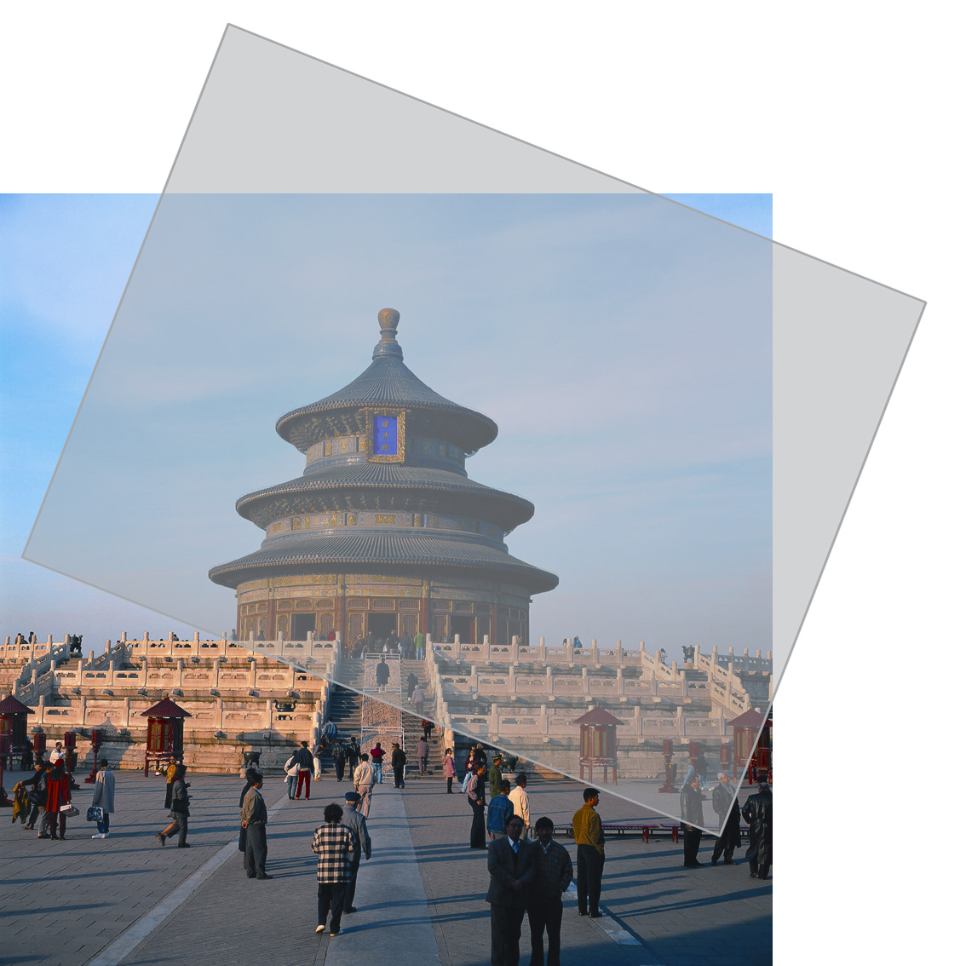
Key Features
Lock and opening
To overlay a film on the image, and view from a certain angle, you will see a hiding pattern on the image
The key to open the lock is the film with special screening

Slide 20
Key Features
Output Pattern
Output the background pattern designed in SuperLine to Founder DocuDefend application
Design
then
output pattern
Imported into
Founder DocuDefend
Application
Copied

Slide 21
Key Features
Module list
Guilloche
Texture
Lace
MicroText
SplitLine
Latent
Lock-Opening
Rasterization
Refraction
Relief
Basic Tools

Slide 22
Advantages

Slide 23
Advantages
Superior price/performance: high end solution at competitive price
Enhanced various security elements
Robust design and layout functionalities
Ease-to-use GUI similar to popular page layout software
Modularized SDK available for OEM

Slide 24
Benefits

Slide 25
Benefits
Cost Effectiveness
SuperLine is digital design software and implements its security features in the printing process, without incurring the extra cost of traditional solutions
Pleasing Aesthetic Effect
Harmonious pattern, grid, and texture
Strong Security Features
Sophisticated, mutable lines and texture
Anti-scanning and anti-replicating

Slide 26
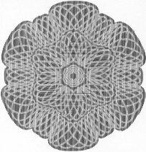
Benefits
Anti-scanning
All the elements are not screen dots but solid lines. If being scanned, they will become dots
Variable line width effectively prevent line work from being scanned
Result can be distinguished by naked eye
Original
Fake

Slide 27
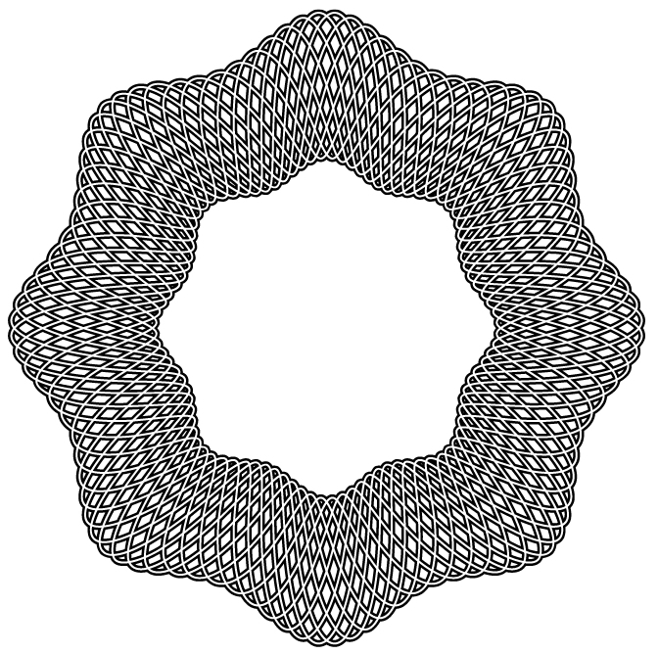
Benefits
Anti-Replicating Cannot be replicated by common layout software including:
Adobe Illustrator
Freehand
CorelDraw…

Slide 28
Benefits
Anti-Replicating
Cannot be replicated even by the same SuperLine software
Some effect based on image where you cannot achieve the same effect without original image
Stochastic parameter is used to prevent forgery

Slide 29
Target Markets

Slide 30
Target Markets
Bank notes and finance
Commercial notes
Certificates, licenses, passports, ID, tickets, lottery, agreements etc. …
Packaging and trademarks
High value goods, and medicines, liquor, tobacco, cosmetics …

Slide 31
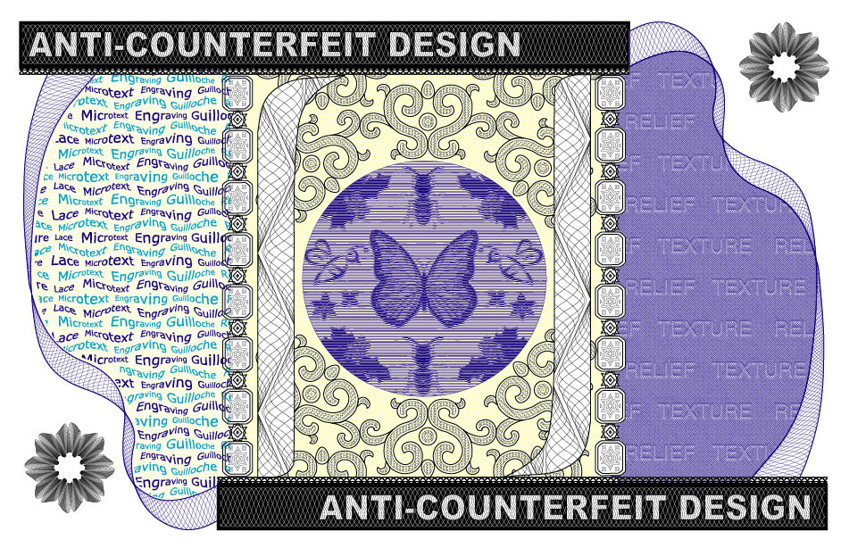
Samples

Slide 32
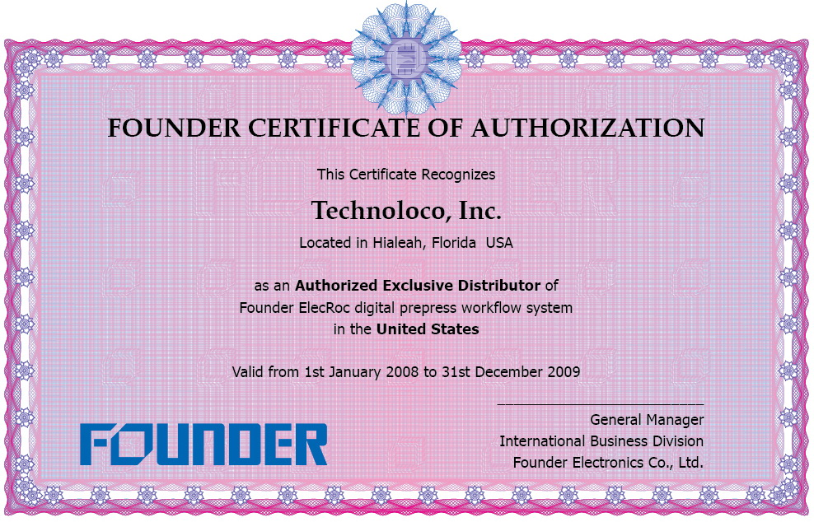
Samples

Slide 33
http://www.founder.com.cn
gasupport@founder.com
Beijing Founder Electronics Co., Ltd.
9, No.5 Street, Shangdi Information Industry Base, Haidian District, Beijing 100085, P.R.China
Tel: +86 10 62981440 Fax: +86 10 62981440
Email: GASales@founder.com.cn

