Slide 1
ElecRoc 5 Training
March, 2011

Slide 2
Content
Introduction
What’s new in ElecRoc 5
Functions of ElecRoc 5
Advanced technology
  EagleFM
  EagleFAM
  Global / Zone Trap
  EcoInk
  Hi Fi print
Tools

Slide 3
Introduction
An integrated JDF/PDF pre-press workflow solution
C/S structure, ease of use
Automatic
Scalable
All-in-one
Advanced technology
Notes:
An Integrated JDF/PDF Pre-press Workflow Solution
Founder ElecRoc is an easy-to-use, scalable workflow solution designed to meet the demands of pre-press professionals. It integrates the latest core technologies from Founder Electronics. ElecRoc provides all the functionality required for job management, integrated JDF/PDF creation, preflight, trap, imposition, PDF color management, 3D preview, EcoInk(ink saving), Hi-Fi print, PDF compare, cooperative task management, output load balancing, zone screen, CIP3 ink control, advanced screen, color/screen proofing, remote color calibration, and output device support. ElecRoc combines automation with process control of the entire workflow in real time.

Slide 4
What’s new in ElecRoc 5?
Installation
  ElecRoc 5 Server supports Windows server 2008 R2 64-bit
  ElecRoc 5 Server supports Windows 7 Professional
  less than 5 users
  ElecRoc 5 Client supports Mac OS X 10.6 system
Notes:
Recommended System Configuration
Hardware Software
Master Server CPU: Intel Dual-Core Xeon 2.66GHz or above Windows Server 2003 SP2
Memory: 4 Gigabyte or above Windows Server 2008 R2 64 bit
Hard Disk: 120GB or above, High Speed SCSI
Display: 1024 x 768 Color, 32 bit true color
Slave Server CPU: Pentium IV 3.0 GHz or above Windows Server 2003 SP2
Memory: 2GB or above Windows Server 2008 R2 64 bit
Display: 1024 x 768 Color, 32 bit true color
Mac Client Power Mac G5 Mac OS X 10.5
Memory: 2 GB or above Mac OS X 10.6
Display: 1280 x 800 Java 1.5 and above
PC Client CPU: Dual-Core 2.8 GHz or above Windows XP SP3
Memory: 2 GB or above Windows 2003 SP2
Display: 1024 x 768 Color, 32 bit true color Windows 7
Windows 2008
Network 100 MB Ethernet

Slide 5
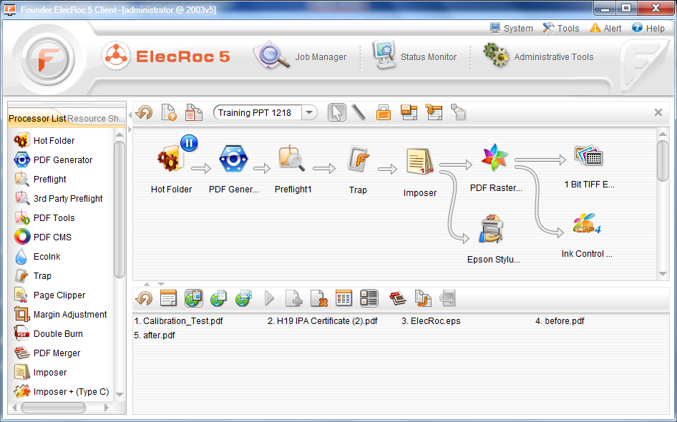
What’s new in ElecRoc 5?
Introduce client
  Log F
  Tool bar
  Job Manager
  Status Monitor
  …….

Slide 6
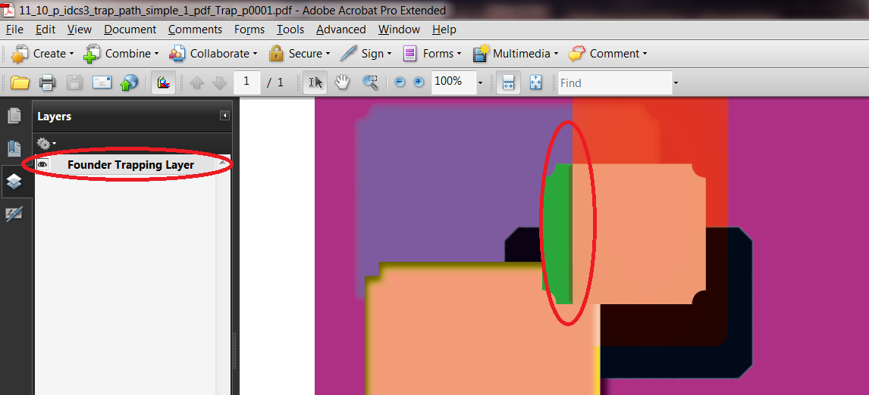
What’s new in ElecRoc 5?
Powerful zone and transparency trap
  Transparency trap
  Image internal trap
Notes:
Founder WiseTrap is based on powerful parameter template settings.
It supports trapping between graphics and images, including
transparent image and bitmap along with spot colors, and generates
smooth sliding traps between bidirectional gradients with sliding trap
function.WiseTrap includes auto trap and zone trap. Auto trap is
widely used in most jobs to achieve automatic production. Zone trap
is used in parts of a job to achieve different trapping results.
Benefit:
• Automatic trap
• Zone trap
• Transparence trap

Slide 7
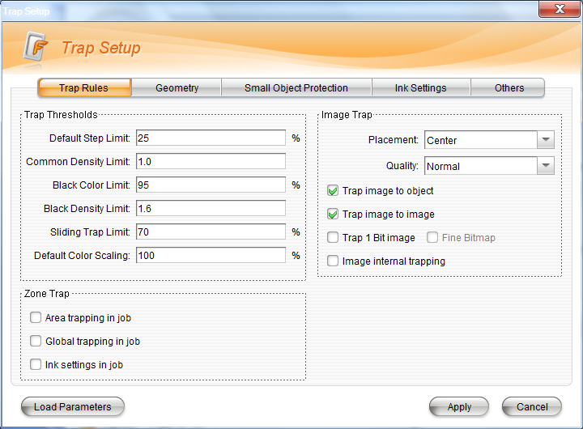
What’s new in ElecRoc 5?
Trap
  Global trap
  Zone trap
  Trap rules
  Geometry
  Small object protection
  Ink settings
  …….

Slide 8
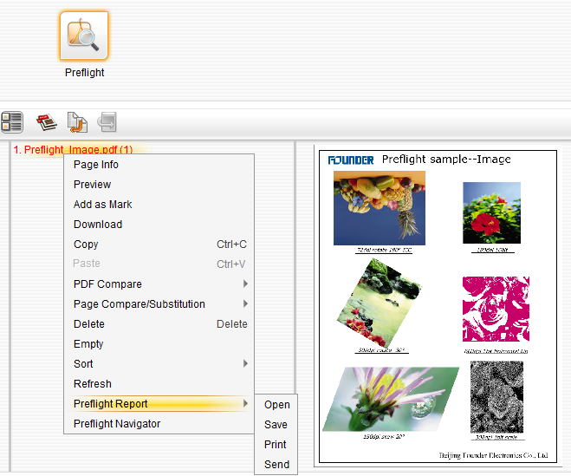
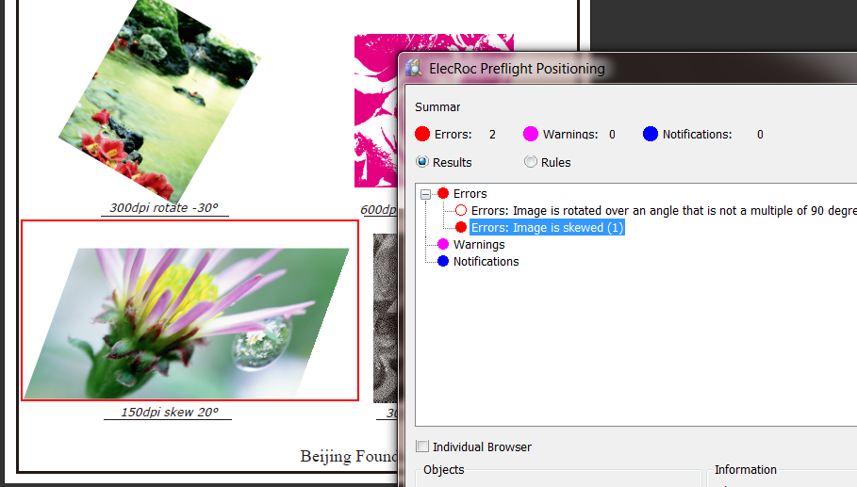
What’s new in ElecRoc 5?
Navigator preflight
  Check out the errors of image, color, font, size, etc
  Navigate to the error or warning parts in the jobs
Notes:
Founder ElecRoc has a PDF preflight module to ensure everything
necessary for a job is present. It has automatic or manual operation
by templates setting. Preflight result can navigate to object of the file
and easy to check or change.
Benefit:
• Auto preflight with template
• Individual setting of preflight node
• Navigate to object
• Send preflight results automatically

Slide 9
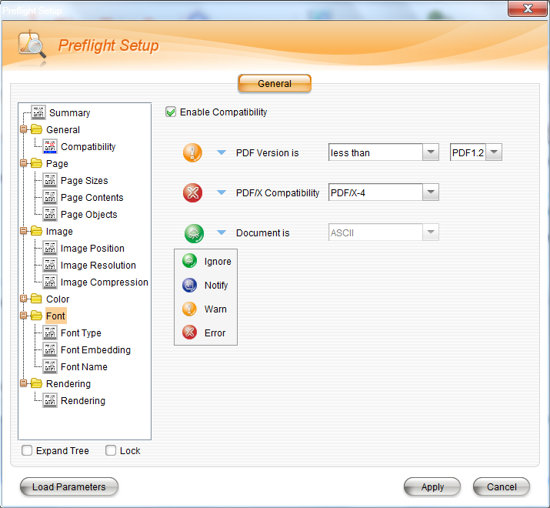
What’s new in ElecRoc 5?
Preflight
  General
  Page
  Image
  Color
  Font
  …….

Slide 10
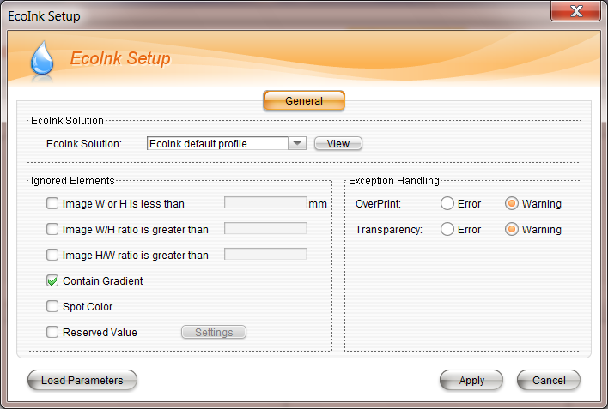
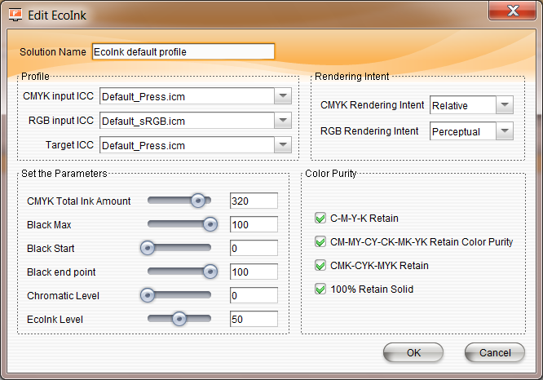
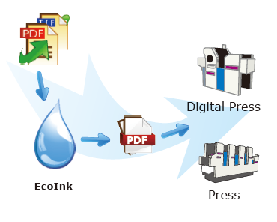
What’s new in ElecRoc 5?
PDF-based EcoInk (ink saving)
  PDF in, PDF out
  Generate ink savings up to 20%
  More accurate color, easier for press
Notes:
Founder EcoInk (ink saving) is a built in color management module developed by Founder, it converts color accurately by loading open industry standard or the customer’s ICC profile. Different ink saving parameters can be set up according to different press requirements and degree of ink saving desired.
EcoInk controls RGB and CMYK images, graphics and spot colors.
EcoInk can generate ink savings up to 20%.
Benefits
• Green printing
• Low carbon
• Saving cost with achieving high color reproduction.

Slide 11
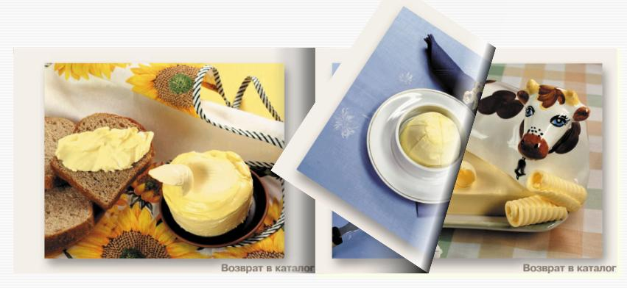
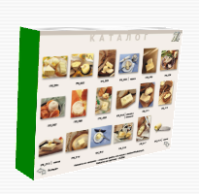
What’s new in ElecRoc 5?
3D booklet preview
  Final effect of paginated jobs more accurately
  Remote preview
Notes:
3D Booklet Preview displays a flash animation of page turning in reader’s spreads. Proofing with 3D booklet preview shows the final effect of paginated jobs more accurately.
Benefit:
• Intuitive flash result
• Save time and money

Slide 12
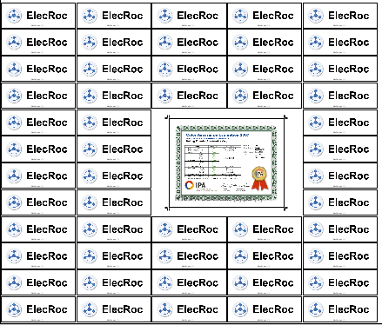
What’s new in ElecRoc 5?
Versatile Ganging to meet different requirements
  Template manager
  Work and Turn/Work and Tumble
  Page Number
  Step and Repeat
  Manual Position
  Dynamic spot color marks
    (comment, marks)
  Import signature from Imposer
Notes:
ElecRoc Imposition Processor allows users to apply imposition
signature templates for CTP jobs. Users can configure binding
type, creep control, bleed control and page location control. Users
can also instantly see previews and make last minute changes to
the imposition. The final imposition is JDF based, thus increasing
the processing speed.
The bran-new Ganging module provides powerful ganging
functions to meet requirements of short-run printing, commercial
printing. It supports interactive ganging on double sides, auto
arrange, auto by pass, step and repeat, supports page number,
auto mark, etc. The new ganging meets the requirements of most
complex binding types.
Benefit:
• Origami to make template intuitively
• Work and Turn, Work and Tumble
• Step and repeat used for digital printing

Slide 13
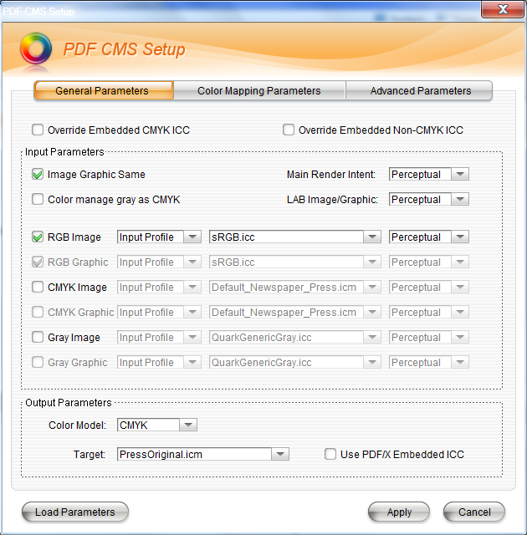
What’s new in ElecRoc 5?
Valuable PDF color management
  PDF CMS changes ICC profiles in PDF file as you want.
Notes:
The new PDF Color Management module is a PDF-level CMS. It is
easy to achieve all sorts of color transformations with its powerful
functions. Using PDF CMS, customers get value-added, for
example, Hi-Fi printing, soft proofing on screen and it supports
remote verification or signature which is based on PDF.
Benefit:
• Flexible
• Convenient

Slide 14
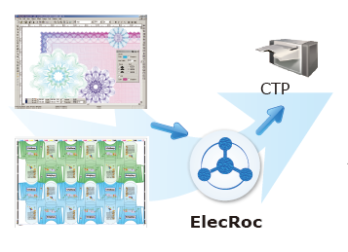
What’s new in ElecRoc 5?
Packaging solution support
  ElecRoc 5 supports packaging solution:
    PaSharp
    SuperLine
Notes:
ElecRoc package printing solution accepts the results of Founder
Anti-counterfeiting design (SuperLine) and packing program
including trap, ganging, spot, etc. All the designs or signatures
can be output to CTP effectively via ElecRoc.
Benefit:
• High effective output

Slide 15
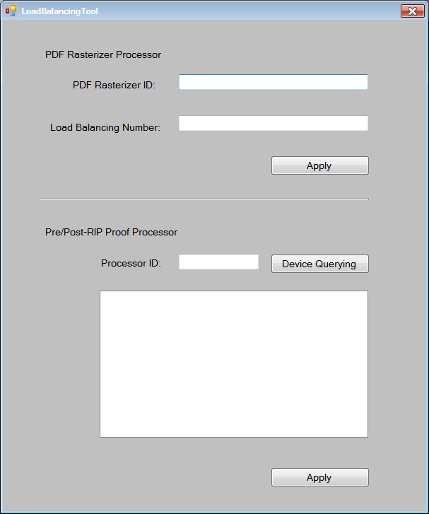
What’s new in ElecRoc 5?
load balancing
  >=4 cores
  Proof load balancing
  Screen load balancing

Slide 16
What’s new in ElecRoc 5?
Converts bitmaps into PDFs
  1 Bit TIFF to PDF
    preview in Adobe Acrobat.
    Selectable PDF resolutions

Slide 17
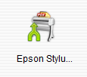
What’s new in ElecRoc 5?
Cooperative task management system
  Share nodes
User A
creates a shared note
submits jobs to
User B

Slide 18
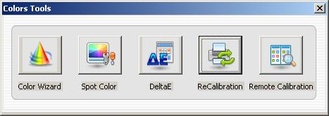
What’s new in ElecRoc 5?
Achieve remote proofing with excellent color management system
  ElecRoc 5 supports remote proofing
  ElecRoc 5 supports recalibration

Slide 19
What’s new in ElecRoc 5?
Proof on printing paper to save costs
  ElecRoc 5 Pre-RIP Proof module supports printing paper
    Much cheaper than special proofing paper
    More reliable of proofing result

Slide 20
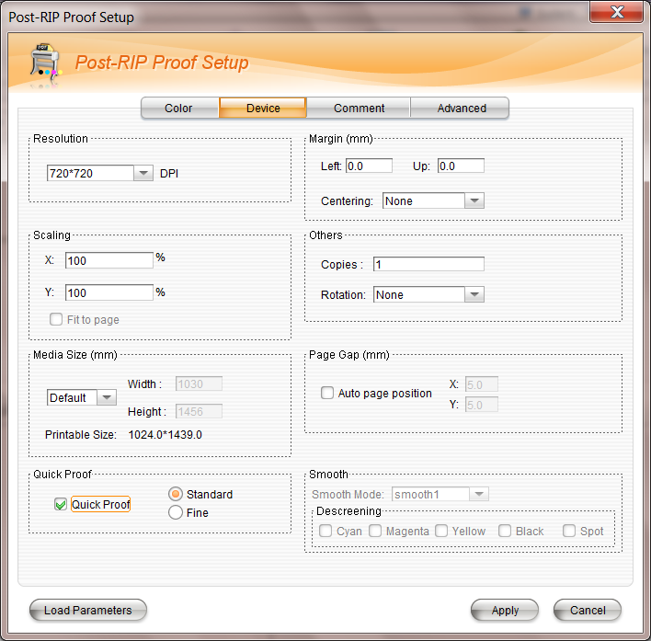
What’s new in ElecRoc 5?
Proofer with 1 Bit TIFF files
  Blue paper proof

Slide 21
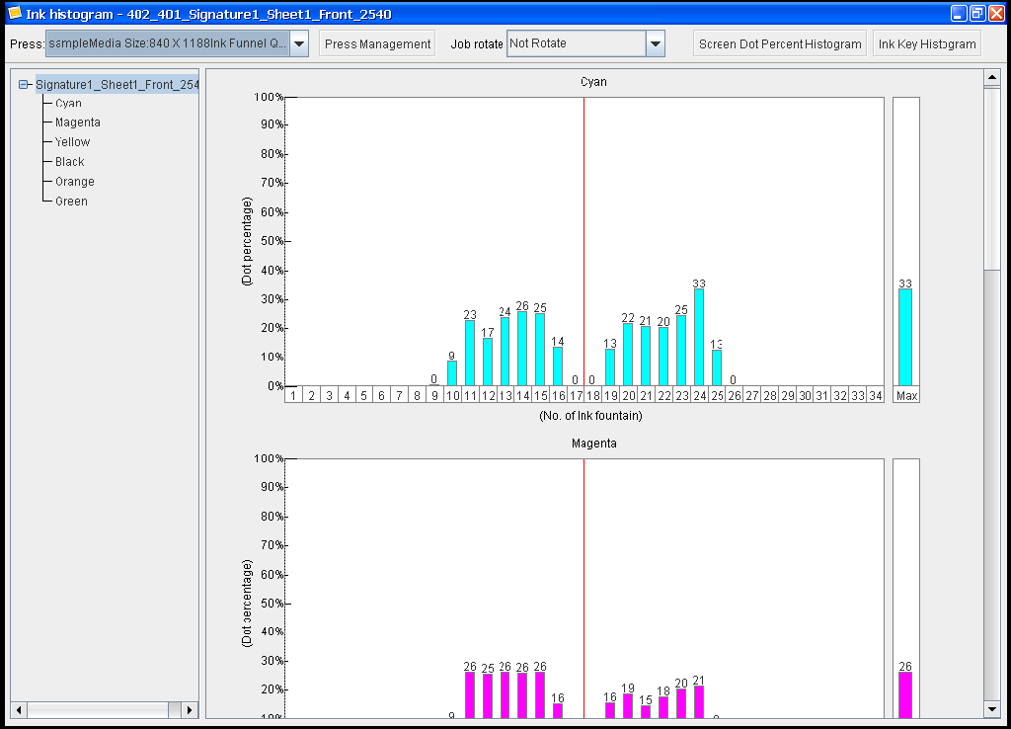
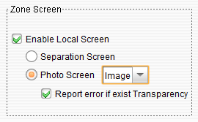
What’s new in ElecRoc 5?
Zone screen and ink histogram in PDF Rasterizer
  ElecRoc 5

Slide 22
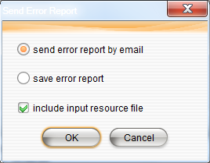
What’s new in ElecRoc 5?
Automatic error report
  ElecRoc 5

Slide 23
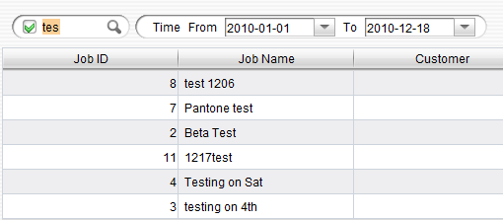
What’s new in ElecRoc 5?
Smart job searching and navigation
  Key words
  date

Slide 24
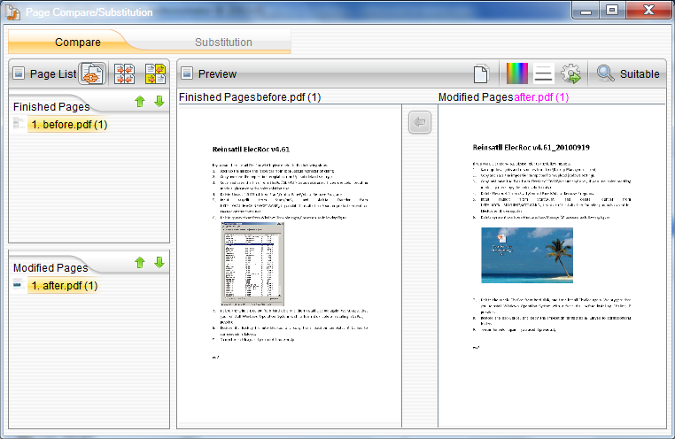
What’s new in ElecRoc 5?
Valuable PDF compare and page substitution
  When the job was modified, PDF compare finds out the changes.
  Page substitution

Slide 25
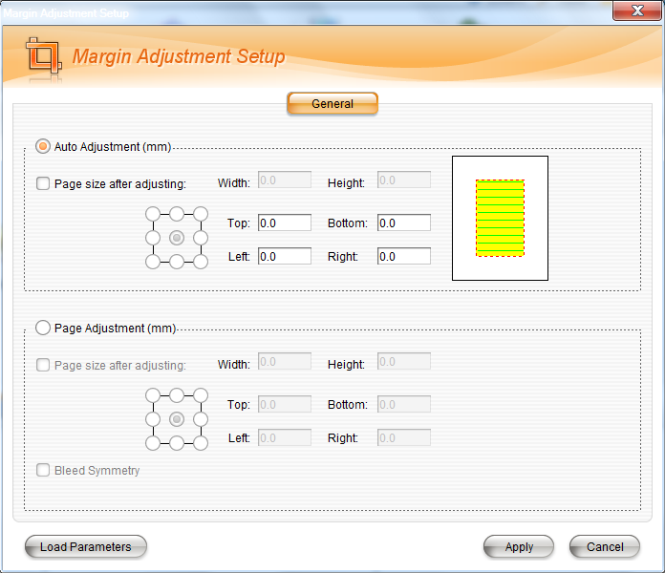
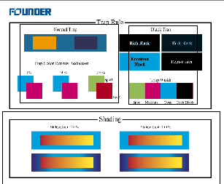
What’s new in ElecRoc 5?
Margin adjustment and Page clipper
  ElecRoc 5

Slide 26
Content
Introduction
What’s new in ElecRoc 5
Functions of ElecRoc 5
Advanced technology
  EagleFM
  EagleFAM
  Globe / Zone Trap
  EcoInk
  Hi Fi print
Tools

Slide 27
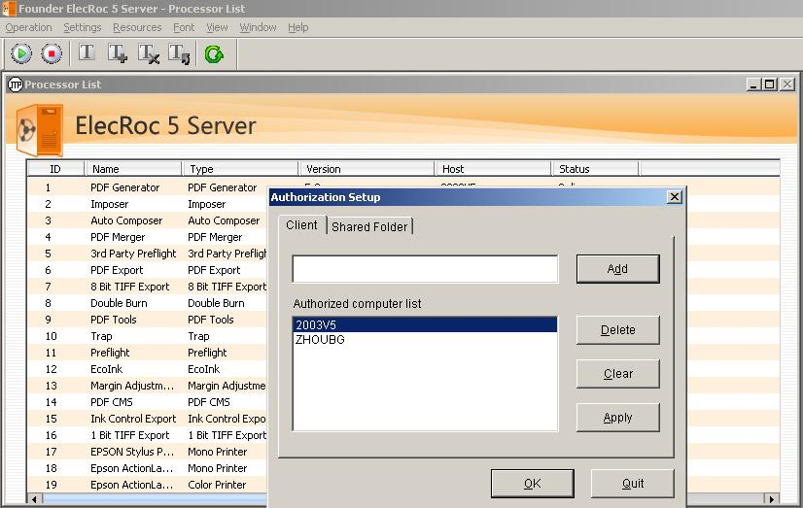
ElecRoc 5 Server
Introduce server
  Tool bar
  General Settings
  Authorization Setup
  …….

Slide 28
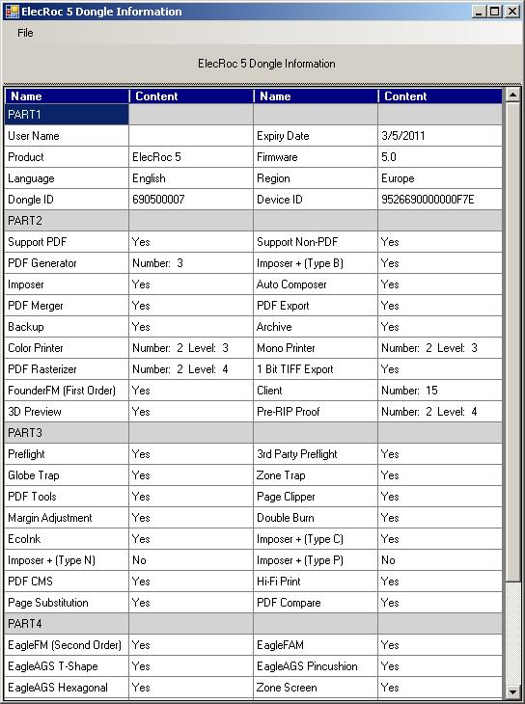
ElecRoc 5 Dongle Information
Introduce Dongle Information
  Part 1 to Part 5
  Print out
  …….

Slide 29
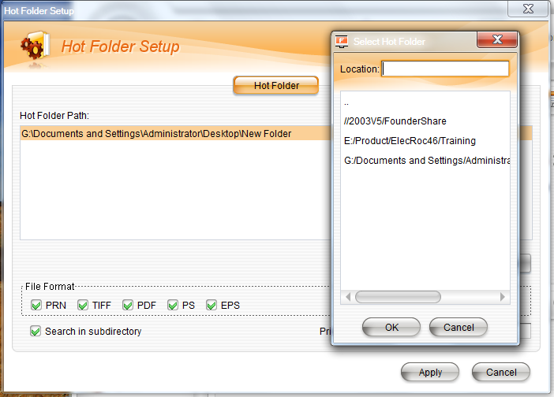
ElecRoc 5 Client
Hot Folder
  Location_ Input Directory on Server
  File Format
  Priority
  …….

Slide 30
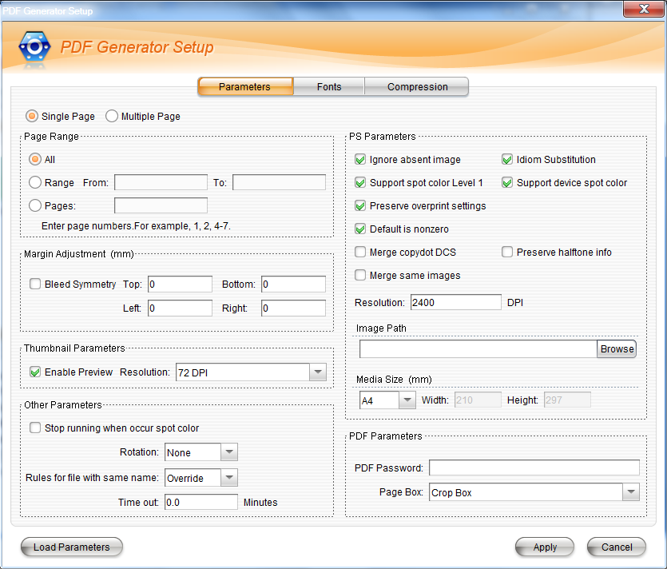
ElecRoc 5 Client
PDF Generator
  PS parameters
  PDF paraeters
  …….

Slide 31
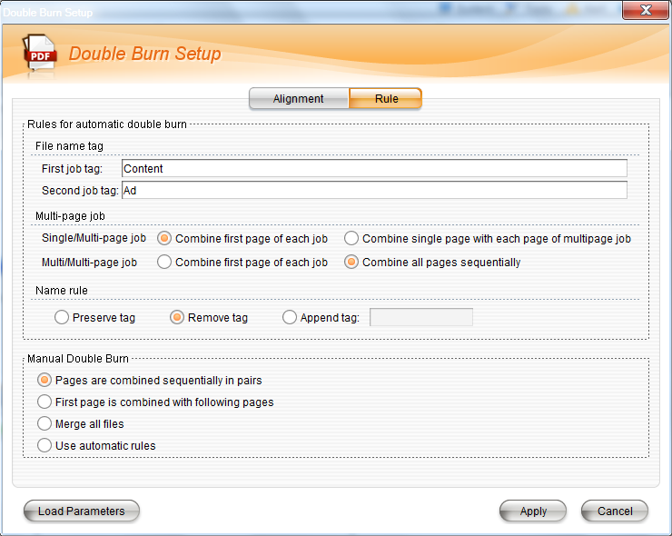
ElecRoc 5 Client
Double Burn
  Merger two pages to one
  Automatically
  Manually
  …….

Slide 32
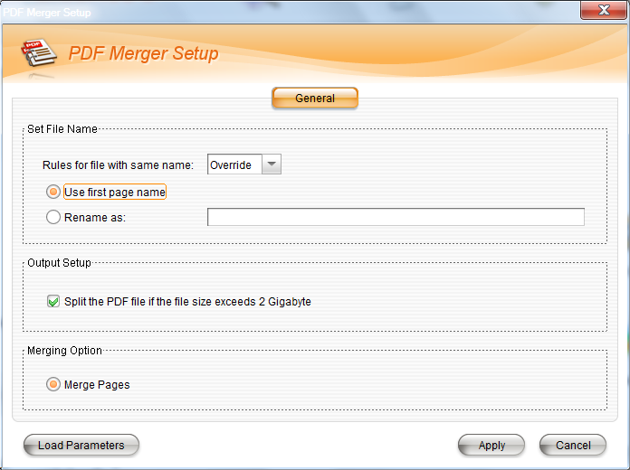
ElecRoc 5 Client
PDF Merger
  Merger two files to one file.
  …….

Slide 33
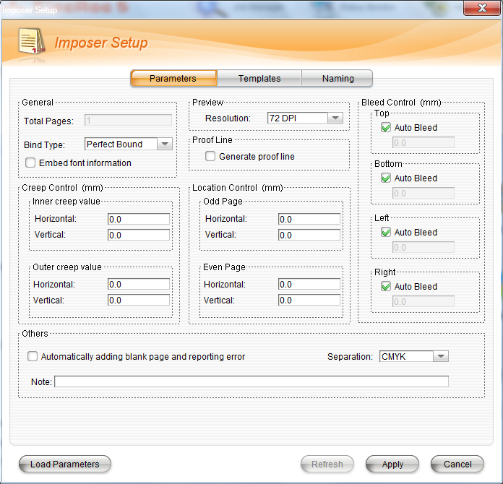
ElecRoc 5 Client
Imposer
  Job-level template
  System-level template
  JDF
  Origami
  Dynamic spot color marks
    (comment, marks)
  …….

Slide 34
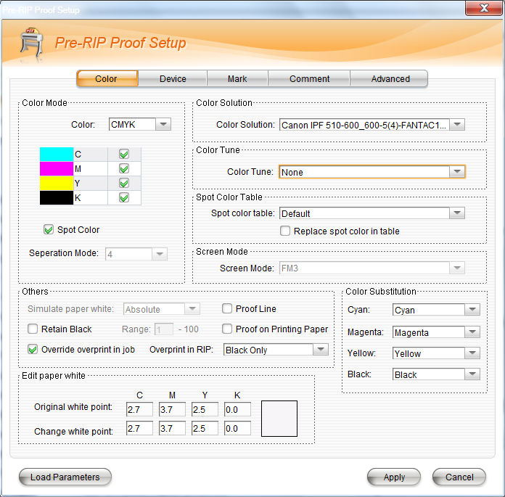
ElecRoc 5 Client
Pre-RIP Proof
  Color solution
  Spot color
  Proof on printing paper
  Paper white
  …….

Slide 35
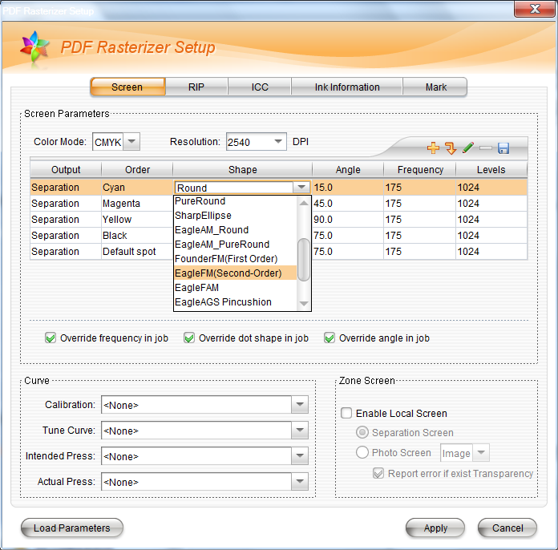
ElecRoc 5 Client
PDF Rasterizer
  Dot shape
  Spot color
  RIP settings
  ICC
  …….

Slide 36
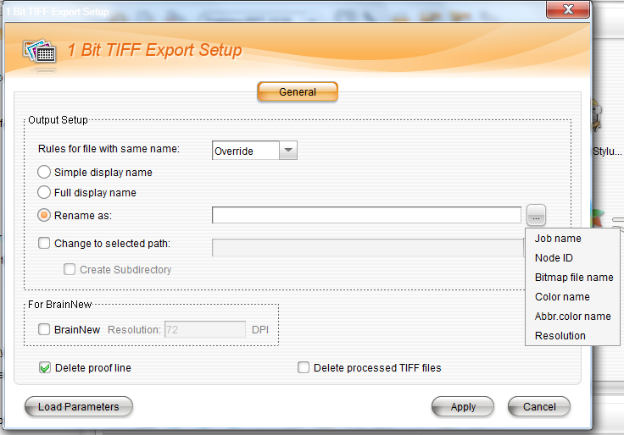
ElecRoc 5 Client
1 Bit TIFF Export
  Simple display name
  Full display name
  Rename as
  …….

Slide 37
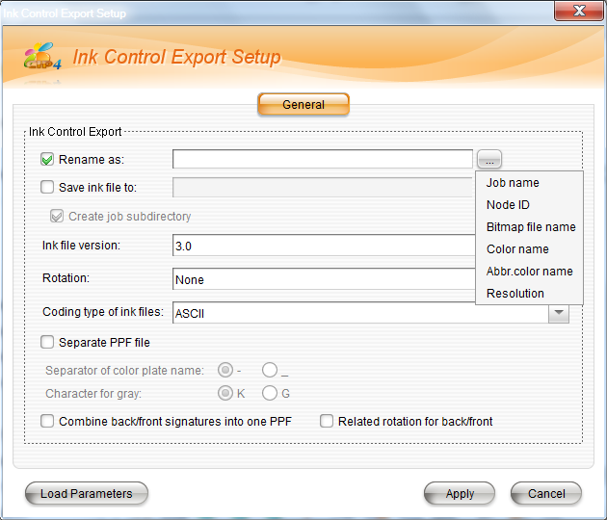
ElecRoc 5 Client
Ink Control Export
  …….

Slide 38
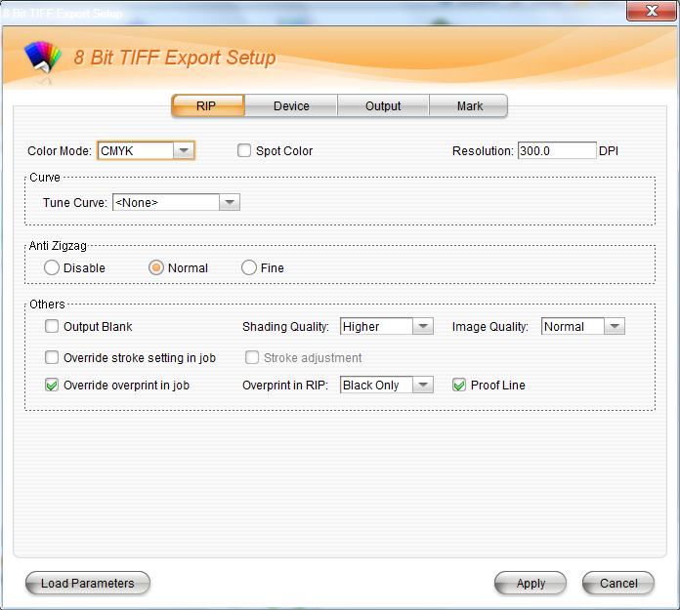
ElecRoc 5 Client
8 Bit TIFF Export
  RIP settings
  …….

Slide 39
Content
Introduction
What’s new in ElecRoc 5
Functions of ElecRoc 5
Advanced technology
  EagleFM
  EagleFAM
  Globe / Zone Trap
  EcoInk
  Hi Fi print
Tools

Slide 40
Advanced Technology
Advanced Screening
Notes:
EagleFAM is based on the technology that utilizes 7.5 angle
screening in midtones and adopts FM screening in highlights and
shadows. Overcomes the weaknesses and combines the
advantages of both conventional AM and conventional FM
screening. It achieves stable quality by using AM screening in
midtones. Eliminate rosettes and moiré patterns created by low
screen angle frequency.
EagleFM: Based on green noise FM technology & Founder Second
Order FM Technology using variable dot size and variable spacing.
Control the randomness of dots, ensuring smooth middle tones.
Smooth transition of continuous tones, keeping details in
overlapping colors. Light area and shadow area can use different
dot sizes for ease of use on press and expanding the color gamut.
Benefit:
• High quality printing for high end users
• Smooth tone and more details on printing

Slide 41
Content
Introduction
What’s new in ElecRoc 5
Functions of ElecRoc 5
Advanced technology
  EagleFM
  EagleFAM
  Globe / Zone Trap
  EcoInk
  Hi Fi print
Tools

Slide 42
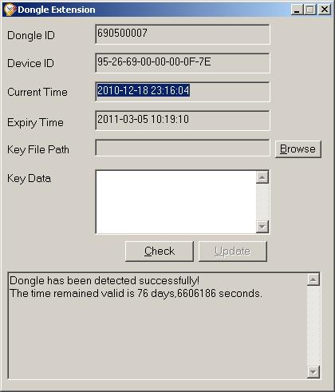
ElecRoc 5 Tools
Dongle Extension
  …….

Slide 43
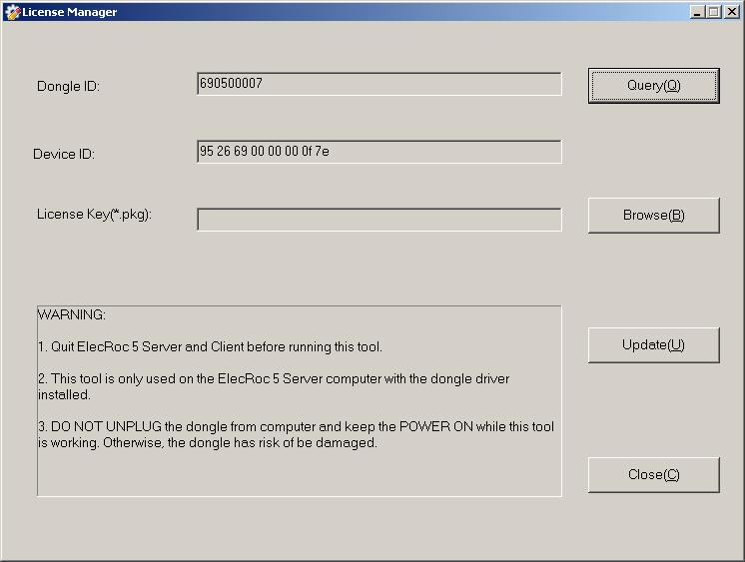
ElecRoc 5 Tools
License Manager
  …….

Slide 44
ElecRoc 5 Tools
Acrobat plug_ins
Color solution converting tool
Imposition template converting tool
Load balancing tool
Restart dongle service
Windows firewall tool
Dongle information
  …….

Slide 45
ElecRoc 5 Dongle Information
Introduce Dongle Information
  Part 1 to Part 5
  Print out
  …….

Slide 46
ElecRoc 5 Tools
Uninstall ElecRoc 5 server

